Slide 1


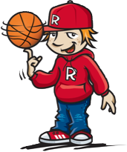

Winning Your Game of Life by having
SELF-CONTROL
1

Slide 2
Becoming a
WINNER in the
“Game of Life”
by showing
SELF-CONTROL
winning your game of life with self-control
2

Slide 3
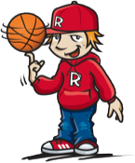
What behaviour would you expect to see in someone with
S
E
L
F
ctrl
?
winning your game of life with self-control
3

Slide 4
S
E
L
F
ctrl
IS A CHOICE
A
G
R
E
E
o
r
D
I
S
A
G
R
E
E
winning your game of life with self-control
4

Slide 5
S
E
L
F
ctrl
IS OFTEN A HARD CHOICE
A
G
R
E
E
o
r
D
I
S
A
G
R
E
E
winning your game of life with self-control
5

Slide 6

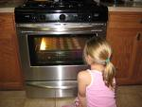



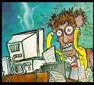
What feelings are shown in these pictures?
Another word for feelings is EMOTIONS
winning your game of life with self-control
6

Slide 7
Negative Emotions
We need to show great SELF-CONTROL when we have negative EMOTIONS
winning your game of life with self-control
7

Slide 8

What are some situations that can give you negative emotions?
FEELING | SITUATION | OPPOSITE FEELING | POSSIBLE SOLUTIONS
That’s when we need to show great
“SELF-CONTROL”
winning your game of life with self-control
8

Slide 9

Kids with put things right
Here’s How...
MUCK UP
Everyone gets things wrong at times
OWN UP
To what you’ve done wrong
PUT IT RIGHT
Think about your choices for
putting it right...
MOVE ON
After you’ve “Put It Right” Learn from your mistakes
winning your game of life with self-control
9

Slide 10

S
E
L
F
ctrl
Put it right formula
MUCK UP
OWN UP
PUT IT RIGHT
OWN UP
Choices
PUT
IT
RIGHT
Choices
Consequences...what could happen?
MOVE ON
The best choice is____________________
____________________________________
because______________________________
winning your game of life with self-control
10

Slide 11
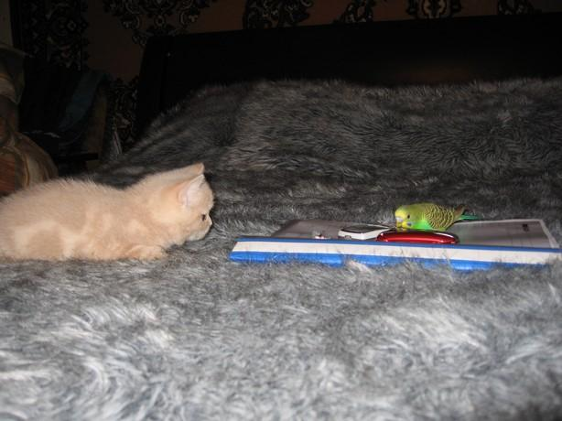
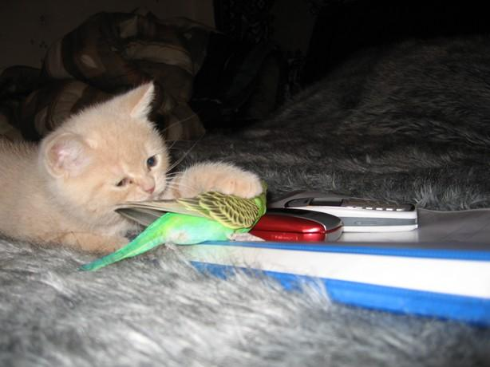
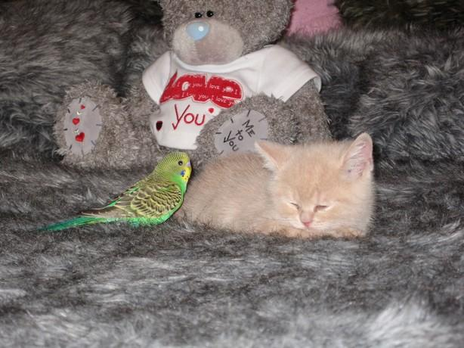
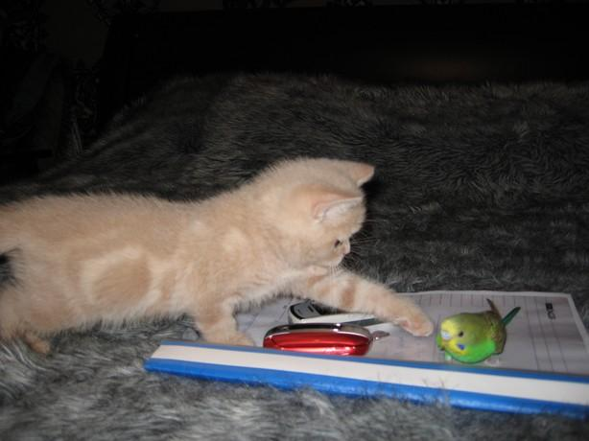
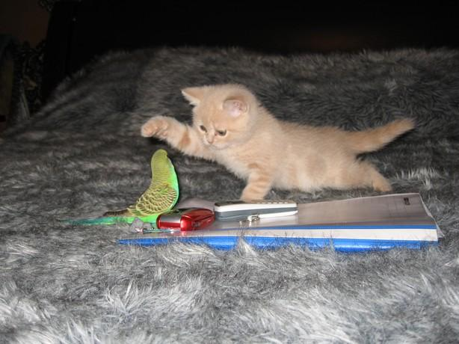
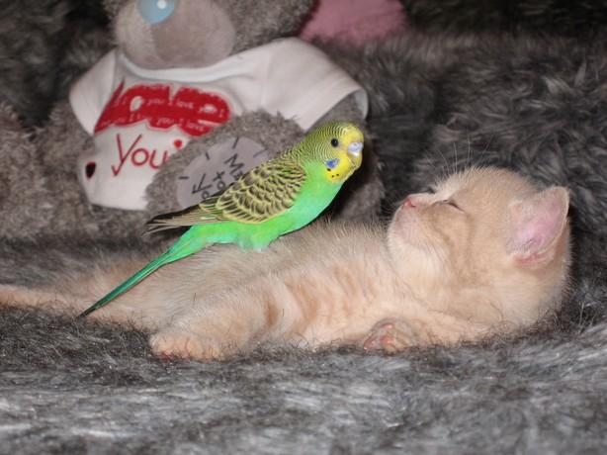
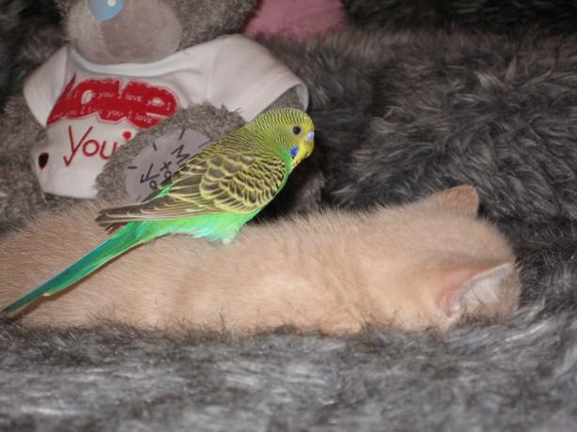
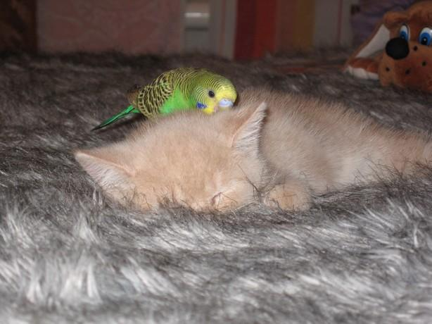
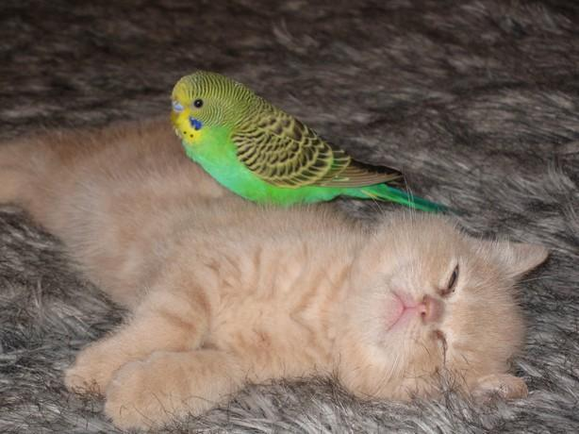
winning your game of life with self-control
11

Slide 12
S
E
L
F
ctrl
Knowing you can but deciding you won’t
winning your game of life with self-control
12

Slide 13
To act with
SELF CONTROL
when we have negative emotions means we need...
PATIENCE
winning your game of life with self-control
13

Slide 14
Becoming a WINNER in “The Game of Life” means...
Acting with
By having PATIENCE
winning your game of life with self-control
14

Slide 15
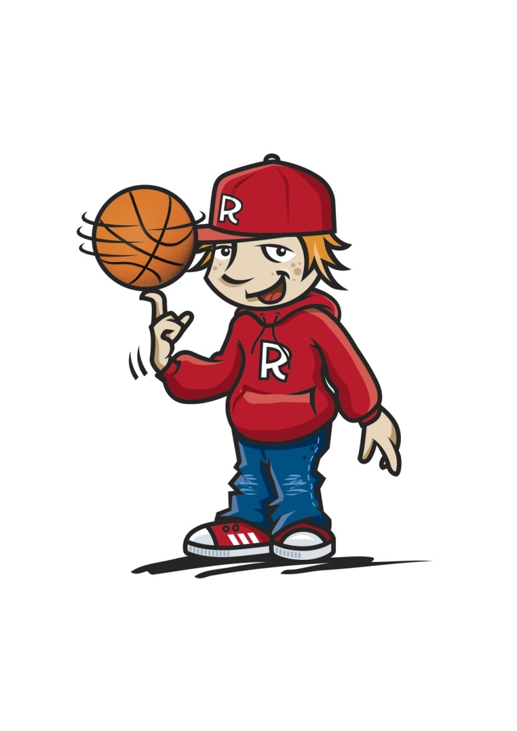
PATIENCE
PATIENCE is important
when learning to act with
winning your game of life with patience
15

Slide 16
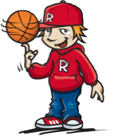
PATIENCE
When negative emotions stir us up we need PATIENCE
winning your game of life with patience
16

Slide 17
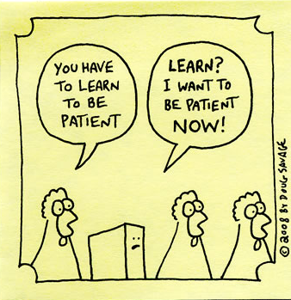

What is patience?
winning your game of life with patience
17

Slide 18
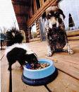

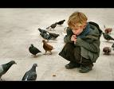
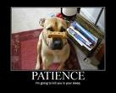
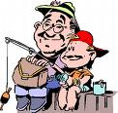

How do these pictures show
PATIENCE?
winning your game of life with patience
18

Slide 19
S
E
L
F
ctrl
PATIENCE
A willingness to wait or accept delays
vs
Wanting what you want when you want it
winning your game of life with patience
19

Slide 20

PATIENCE
Is an action!!
Learning to WAIT is an action
winning your game of life with patience
20

Slide 21
PATIENCE
is not something you are
born with...it’s a skill
What are some skills you need to practice to play a game?
In the same way you need to practice PATIENCE to develop SELF-CONTROL
winning your game of life with patience
21

Slide 22
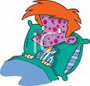
PATIENCE
Once upon a time their was a little boy who was sick and confined to his bed.
winning your game of life with patience
22

Slide 23

PATIENCE
It was just before Christmas so the family decided that the Christmas tree would be put up in his bedroom.
winning your game of life with patience
23

Slide 24
PATIENCE
The night before Christmas the excitement just got too much and his curiosity got the better of him.
winning your game of life with patience
24

Slide 25
PATIENCE
With his sister’s help, one by one, he retrieved the gifts from under the tree.
winning your game of life with patience
25

Slide 26
PATIENCE
His sister could read the labels and if his name was on the label, he took it as an omen that the gift was to be immediately unwrapped.
winning your game of life with patience
26

Slide 27

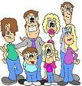
PATIENCE
The next morning while everyone else was sharing in the excitement of opening the gifts they had received, he lay there with nothing to open.
winning your game of life with patience
27

Slide 28
PATIENCE
However he had only one gift to open that had managed to escape his previous night's inspection.
winning your game of life with patience
28

Slide 29
PATIENCE
What lessons can we learn about Patience from this story?
winning your game of life with patience
29

Slide 30






PATIENCE
“Patience serves as a protection against wrongs as clothes do against cold. For if you put on more clothes as the cold increases, it will have no power to hurt you….”
winning your game of life with patience
30

Slide 31
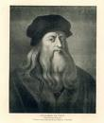
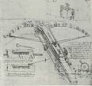
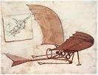


PATIENCE
So in like manner you must grow in patience when you meet with great wrongs and they will then be powerless to vex (annoy) you.”
Leonardo do Vinci, painter, engineer, musician and scientist (1452 - 1519)
winning your game of life with patience
31

Slide 32


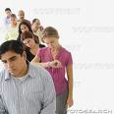

IMPATIENCE
The opposite to Patience
What things make you IMPATIENT with…
Your friends, classmates, others in the playground or your family?
winning your game of life with patience
32

Slide 33

IMPATIENCE
Learning to take turns
Patient people learn to take turns
What ideas can you come up with to help sort out situations when others always want things their way?
winning your game of life with patience
33

Slide 34


IMPATIENCE
Taking Turns
By: Jacqueline Jules
Last night I stood watching
as colours spread across the sky.
Once again, the sun was setting.
Once again, I wondered why.
They say the earth is spinning
every second, round and round.
Why don’t I feel it moving
when I’m standing on the ground?
winning your game of life with patience
34

Slide 35
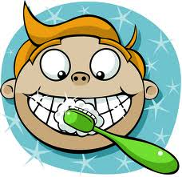



IMPATIENCE
They say when evening comes
and I brush my teeth for bed,
children way across the globe
are waking up instead.
Could that be the reason
we lose the sun each night?
The world is taking turns
I think that's quite polite.
winning your game of life with patience
35

Slide 36
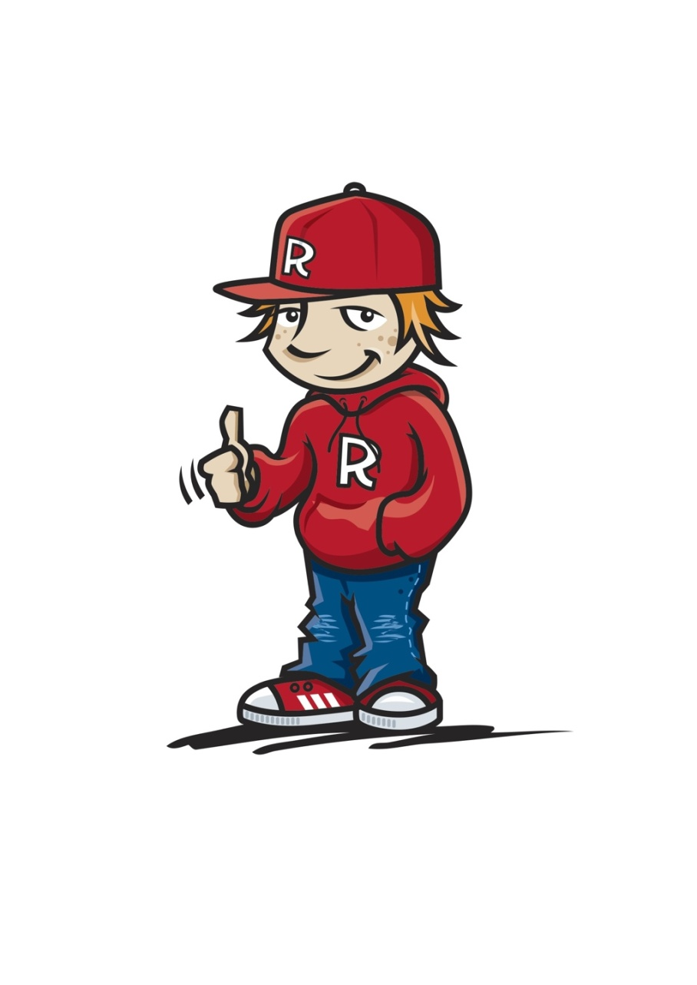
IMPATIENCE
Hurts Friendships
Impatience with others makes us more critical of others and hurts friendships
Has this ever happened to you?
winning your game of life with patience
36

Slide 37
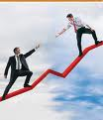
IMPATIENCE
Hurts Friendships
What strategies can you put in place that could help you with:
Friends?
Classmates?
Others in the playground?
Family?
winning your game of life with patience
37

Slide 38







Developing my PATIENCE...
Strategy Planner
Friends
winning your game of life with patience
38

Slide 39
Becoming a
WINNER
in the
“Game of Life”
Requires
PATIENCE
By learning to
WAIT
winning your game of life with patience
39

Slide 40



Quick REACTIONS
What are some of the things we SAY when we “erupt?”
What are some of the things we DO when we “erupt?”
S
E
L
F
ctrl
40

Slide 41
Slow REACTIONS
What are some of the words to describe this reaction ?
S
E
L
F
ctrl
41

Slide 42
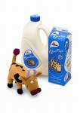



Quick REACTION
Slow REACTION
What are some of the main differences between quick & slow reactions?
S
E
L
F
ctrl
42

Slide 43
Slow v Quick REACTIONS
Would you expect to see slow or quick reactions if they are people acting with...
S
E
L
F
ctrl
winning your game of life with slow reactions
43

Slide 44

People who REACT slowly
show GREAT
SELF-CONTROL
They use TIME to THINK
about what to...
SAY and DO
winning your game of life with thinking time
44

Slide 45
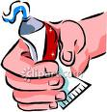
People who REACT slowly
show GREAT
SELF-CONTROL
Words like Toothpaste
can’t be put back!!
winning your game of life with thinking time
45

Slide 46

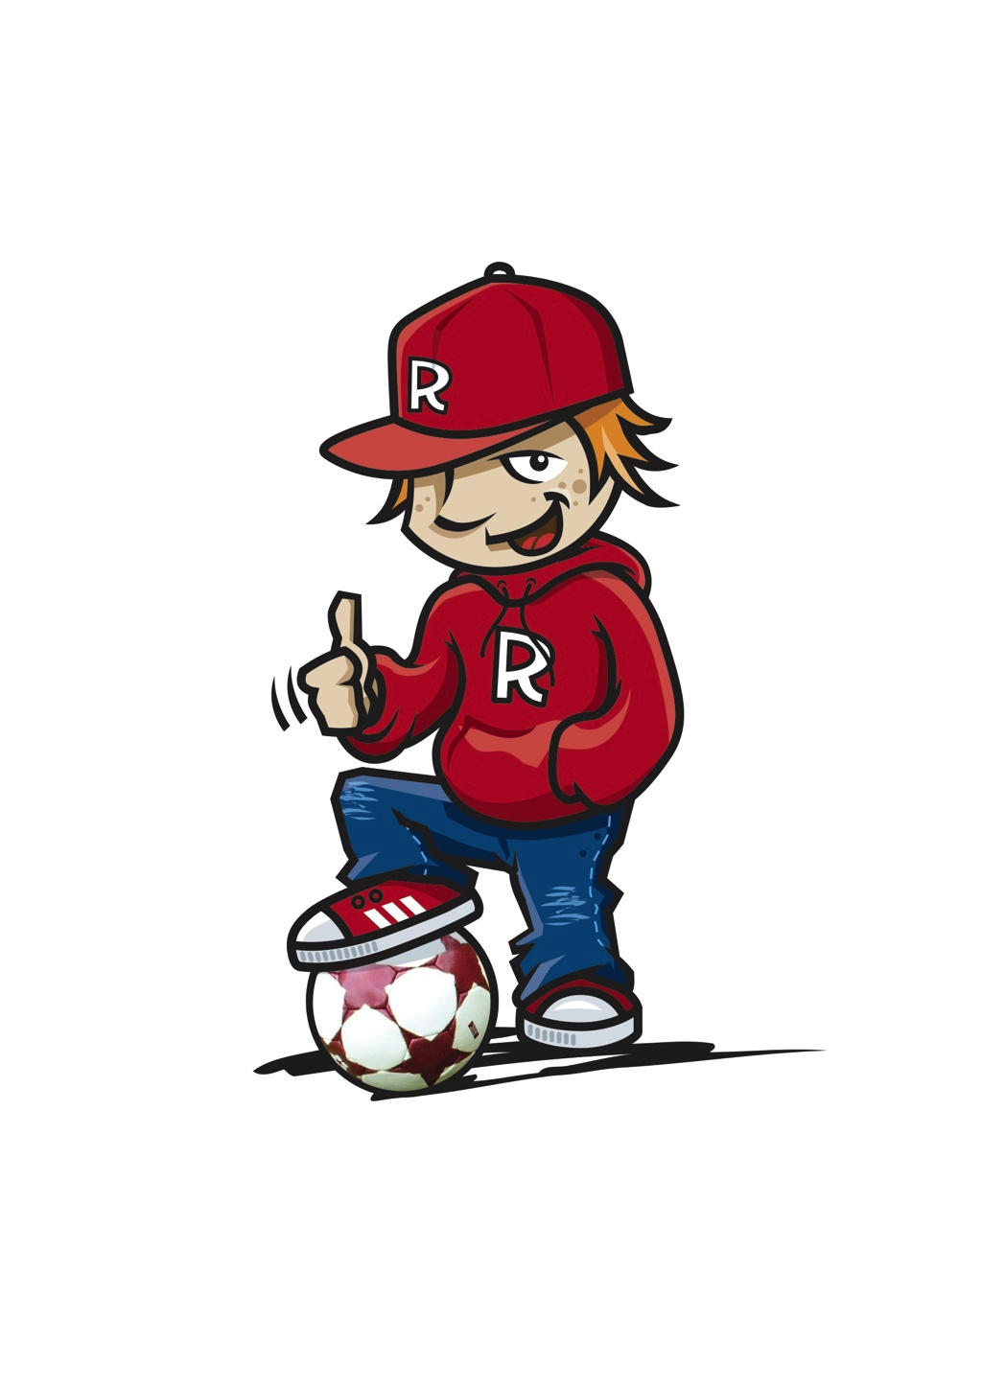
Reactions
Reacting to Failure
“There are no failures just experiences and reactions to them.”
winning your game of life by learning from failure
46

Slide 47


47

Slide 48

Reactions
Reacting to Failure
“There are no failures just experiences and reactions to them.”
What are things you feel you have failed at with:
Your friends?
Your learning at school?
Your family?
winning your game of life by learning from failure
48

Slide 49
Reactions
Reacting to Failure
“There are no failures just experiences and reactions to them.”
How did you react?
How might your reaction show better self-control next time?
winning your game of life by learning from failure
49

Slide 50
Learning from Failure
What did you fail at?
Feelings
What choices can I make next time | . . .
Decide on the best choice and do it | The best choice is
winning your game of life by learning from failure
50

Slide 51

REACTING to Mistakes
4 Kinds of Mistakes
1. Stupid Mistakes:
Dumb things that just happen e.g. stubbing your toe, dropping a tray, poking yourself in the eye
What has happened to you?
winning your game of life by fixing mistakes
51

Slide 52
REACTING to Mistakes
4 Kinds of Mistakes
2. Simple Mistakes
Mistakes that are avoidable but your decision making meant that a mistake was made e.g. not enough food at a party
Can you think of other mistakes like this?
winning your game of life by fixing mistakes
52

Slide 53
REACTING to Mistakes
4 Kinds of Mistakes
3. Involved Mistakes:
Mistakes that require an effort to overcome e.g. getting to school on time, forgetting your lunch
What “involved mistakes”
have happened to you?
winning your game of life by fixing mistakes
53

Slide 54
REACTING to Mistakes
Involved Mistakes
Are like “bad habits” that you need to change
What are some “Bad Habits” you might need to change?
winning your game of life by fixing mistakes
54

Slide 55
Creating New Habits
What is the habit I want to change? | The habit I want to change is...
What are some things I can do to help me change this habit? | . . .
Choose one of the ideas and work on it this week | This week to help create a new habit I’m going to
winning your game of life by creating new habits
55

Slide 56
REACTING to Mistakes
4 Kinds of Mistakes
4. Complex Mistakes:
Sometimes we can’t fix these mistakes because we don’t have the correct knowledge
winning your game of life with fixing mistakes
56

Slide 57

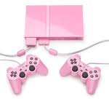
REACTING to Mistakes
Complex Mistakes
I remember as a kid when our beloved Play Station game system started showing static on the screen during games.
The solution my brother and I came up with? Smack the machine as hard as we could. Amazingly this worked for awhile, but after weeks of regular beatings the delicate electronics eventually gave out.
We were lazy, ignorant and impatient, and couldn’t see that our solution would work against us.
Has this type of mistake happened to you?
57

Slide 58

REACTING to Mistakes
Fixing mistakes
Did it...
Hurt yourself or anyone else?
Make you feel embarrassed?
Make you feel frustrated?
winning your game of life by fixing mistakes
58

Slide 59
REACTING to Mistakes
Fixing mistakes
Is there information you know now that would have been useful when you made the mistake?
What would you do differently if in this exact situation again?
How can you avoid getting into situations like this?
Come up with a “Game Plan” to improve the situation next time.
winning your game of life by fixing mistakes
59

Slide 60
REACTING to Mistakes
My Game Plan
When I hurt someone I can
What information will help me not make the same mistake?
When I feel embarrassed I can:
Next time I’m in this situation I can...
When I feel frustrated I can:
How can we avoid getting into situations like this?
winning your game of life by fixing mistakes
60

Slide 61
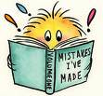

REACTING
to making mistakes
Mistakes are 1 step closer to success
winning your game of life by fixing mistakes
61

Slide 62



Becoming a
WINNER
in the
“Game of Life”
means
Reacting Slowly
Learning from failures
Fixing mistakes
winning your game of life by fixing mistakes
62

Slide 63
Becoming a
WINNER
in the game of life
Requires
SLOW REACTIONS
By learning to
THINK
about what to
SAY
and DO
winning your game of life with slow reactions
63

Slide 64
Self-Control Review
Patience
means
Waiting
Slow Reactions
gives us
Thinking Time to think about...
What to say
and
What to do
winning your game of life with self-control
64

Slide 65
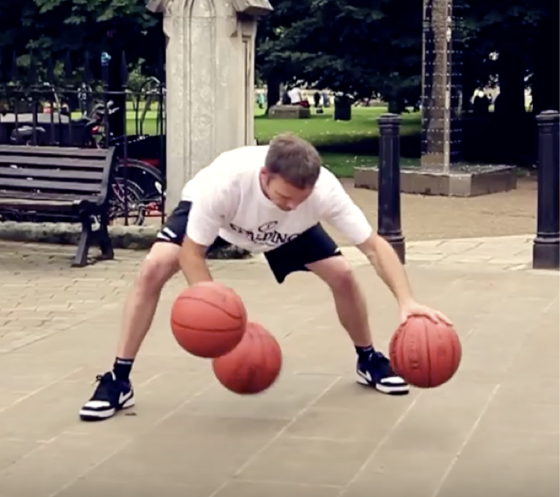
https://www.youtube.com/watch?v=l5rtBYYQhEs
65

Slide 66
Discipline
What parts of his body did he use to
control the ball?
Does the ball need to be moving to have control?
How do you think he became so good
at doing tricks with the balls?
Why do you think he might want to become
really good at these tricks?
winning your game of life with discipline
66

Slide 67
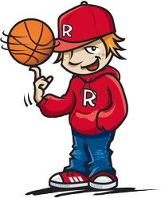
Discipline
Definitions include:
An ability to follow instructions
Respect for authority
Doing what’s right even when others aren’t looking
winning your game of life with discipline
67

Slide 68

DISCIPLINE
The bridge
between “GOALS” &
ACCOMPLISHMENTS
winning your game of life with discipline
68

Slide 69

The first person to discipline is...
YOURSELF
winning your game of life with discipline
69

Slide 70

Disciplining yourself
is called...
SELF-DISCIPLINE
Definition: Doing certain tasks even when you don’t feel like it!!
winning your game of life with discipline
70

Slide 71
Disciplining yourself
is called...
SELF-DISCIPLINE
Definition: Doing what you know is best and doing it gladly
versus
just doing what you want
winning your game of life with discipline
71

Slide 72
SELF-DISCIPLINE
How much Self-discipline do you have?
Answer yes or no to these statements
Shower or bathe every day
Get up in time to not be rushed or arrive late to school
Go to bed at a set time each night
winning your game of life with discipline
72

Slide 73
SELF-DISCIPLINE
Answer yes or no to these statements
Your bed is made and your room neat
Your desk or tote tray at school is tidy
You keep your promises
You play outside more than watching TV or playing on the computer
winning your game of life with discipline
73

Slide 74
SELF-DISCIPLINE
Answer yes or no to these statements
You finish homework on time
You stay on task at school and aren’t easily distracted
Your appearance is neat and tidy i.e. hair tidy and clothes neat
Your lunch box has more freshly made food than packaged food
winning your game of life with discipline
74

Slide 75
SELF-DISCIPLINE
Answer yes or no to these statements
You have a book that you are reading
If you get pocket money you save some instead of spending it
Count up how many YES versus NO answers you have
winning your game of life with discipline
75

Slide 76
DISCIPLINE
SELF-DISCIPLINE
If you have more YES than NO answers you have good SELF DISCIPLINE!
winning your game of life with discipline
76

Slide 77
Building up my SELF-DISCIPLINE
By setting some goals and designing a “Game Plan”
Set small achievable “Action Steps”
winning your game of life with discipline
77

Slide 78
My Game Plan
My Personal Goal is to.... I want to achieve this by...
My action steps are... (Remember to make them small and achievable)
This week my action step is...
I am going to do my action steps on...
winning your game of life with discipline
78

Slide 79
Building up my SELF-DISCIPLINE
I can build up my SELF-DISCIPLINE by...
Using my “WILLPOWER”
winning your game of life with discipline
79

Slide 80
Building up my SELF-DISCIPLINE
Willpower
Is my ability to just
“DO IT!”
winning your game of life with discipline
80

Slide 81

Building up my SELF-DISCIPLINE
“WILLPOWER”
acts like a “Rocket Booster” to get you started
It gives you short powerful bursts
winning your game of life with discipline
81

Slide 82
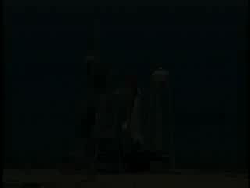
82

Slide 83
Building
SELF-DISCIPLINE
Will Power helps you to...
Persevere
Survive hardships
Do things you don’t always like
What are some things you don’t enjoy doing but you know that it’s good for you?
winning your game of life with discipline
83

Slide 84

Building
SELF-DISCIPLINE
Will Power helps you to...
Reject immediate satisfaction for something better
Gives you a feeling of more power to strive for your goals
winning your game of life with discipline
84

Slide 85
Benefits of Having Strong
SELF-DISCIPLINE
Helps you to do things you don’t always want to do
What will you do in these situations?
An older person gets onto the bus but there are no seats left for them to sit in
Mum asks you to do the dishes but you are feeling tired after a hard day at school
winning your game of life with discipline
85

Slide 86
Benefits of Having Strong
SELF-DISCIPLINE
Helps you to do things you don’t always want to do
What will you do in these situations?
Your room is a mess and your parents have asked you to clean it up. Your friend is pestering you to come out and play
winning your game of life with discipline
86

Slide 87
Benefits of Having Strong
SELF-DISCIPLINE
Helps you to do things you don’t always want to do
What will you do in these situations?
It’s time for training (or music practice) but you have just got a new computer game you really want to play
winning your game of life with discipline
87

Slide 88
Benefits of Having Strong
SELF-DISCIPLINE
Helps you make good choices
Creates happiness and harmony with yourself and others
Gives you control over your life
winning your game of life with discipline
88

Slide 89
Benefits of Having Strong
SELF-DISCIPLINE
Helps you make good choices
Tell yourself it’s important to be done even when you don’t feel like it
winning your game of life with discipline
89

Slide 90
Benefits of Having Strong
SELF-DISCIPLINE
Helps you make good choices
You become stronger when you do things you don’t want to do
Creates “Good Habits”
winning your game of life with discipline
90

Slide 91
Benefits of Having Strong
SELF-DISCIPLINE
Helps you overcome laziness
Unlocks the keys
To your potential
winning your game of life with discipline
91

Slide 92






SELF-DISCIPLINE
Making Right Choices for Everyone
What’s confusing about these signs?
What actions of self-discipline will help your relationships with your friends?
winning your game of life with discipline
92

Slide 93




SELF-DISCIPLINE
Making Right Choices for Everyone
What of actions self-discipline will really help our class become a GREAT community to be part of?
winning your game of life with discipline
93

Slide 94



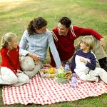

SELF-DISCIPLINE
Making Right Choices for Everyone
What of actions self-discipline will help your relationships at home?
winning your game of life with discipline
94

Slide 95

the World by...
Impacting the community around you...
“Everyone thinks of changing the world but no one thinks of changing themselves.”
By Leo Tolstoy
winning your game of life with discipline
95

Slide 96
the World by...
“Everyone thinks of changing the world but no one thinks of changing themselves”
By Leo Tolstoy
What do you think the writer means?
Do you agree with this?
winning your game of life with discipline
96

Slide 97
the World by...
“Everyone thinks of changing the world but no one thinks of changing themselves”
By Leo Tolstoy
How could you “Impact the World” by changing yourself?
With your friends
At school
At home
winning your game of life with discipline
97

Slide 98

the World by changing myself
With my friends I’m going to...
At school I’m going to...
At home I’m going to...
winning your game of life with discipline
98

Slide 99
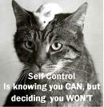
“SELF-CONTROL is a
C H O I C E ”
That CHOICE is YOURS
winning your game of life with self-control
99

Slide 100

S
E
L
F
ctrl
Review
Patience
means learning to
WAIT
Wanting it
NOW!!
v
winning your game of life with patience
100

Slide 101
S
E
L
F
ctrl
Review
SLOW REACTIONS
gives you time to
THINK about what to
SAY
&
DO
winning your game of life with slow reactions
101

Slide 102
S
E
L
F
ctrl
Review
DISCIPLINE
The bridge between your
GOALS
and
ACHIEVING THEM
winning your game of life with discipline
102

Slide 103

Becoming a WINNER in the
“Game of Life”
means to act with
S
E
L
F
ctrl
by
Showing PATIENCE
REACTING slowly
and showing DISCIPLINE
winning your game of life with self-control
103

