Slide 1


Winning in the Game of Life
Achieving Your Goals
1

Slide 2
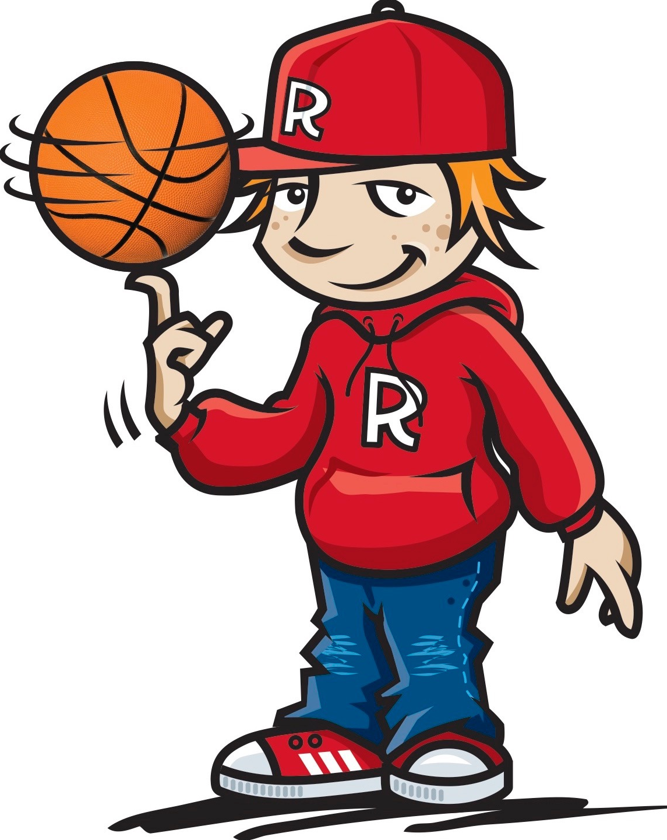
Tommy Baker Basketball Free-styler
https://www.youtube.com/watch?v=8-OluFATctM
2

Slide 3
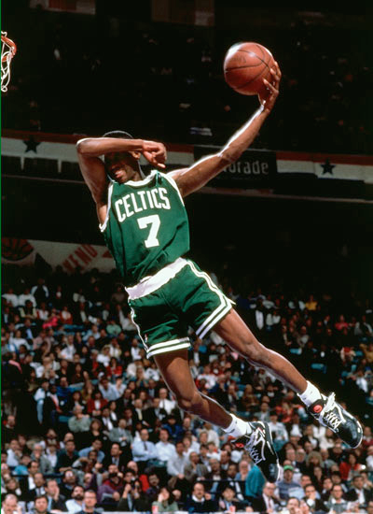
How do you think basketball players become so good?
Stay focused...Achieve your dreams
3

Slide 4

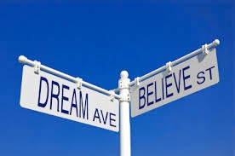

Your Dreams
What dreams do you have?
What do you want to do or be when you grow up?
Why?
Who is someone you’d like to be like?
Why?
Dream It
Believe It
Achieve It
Stay focused......Achieve your dreams
4

Slide 5
What is the main objective of a game?
What can happen in a game that takes your focus off the objective of the game?
Dream It
Believe It
Achieve It
Stay focused......Achieve your dreams
5

Slide 6




Shooting for your Goals
My “BEING” Goals
What kind of person do you want to “BE”
With your friends?
@ School?
@ Home?
What actions can you take to BE a “Better than Before” person?
Dream It
Believe It
Achieve It
Stay focused......Achieve your dreams
6

Slide 7
Shooting for your Goals
My “DOING” Goal
What “actions” do you want to try and improve... so that you can be “Better than Before?”
What actions do you need to take to improve these?
Dream It
Believe It
Achieve It
Stay focused......Achieve your dreams
7

Slide 8
Shooting for your Goals
My “Being” Goal by
_____________________
My “Being” Goal is
______________________
This goal is important to me because
____________________________________________________________________
______________________________________
Dream It
Believe It
Achieve It
Stay focused......Achieve your dreams
8

Slide 9
Shooting for your Goals
My “Doing” Goal by
_____________________
I want to become better at
______________________
This goal is important to me because
_____________________________
_____________________________
_________________________________
Dream It
Believe It
Achieve It
Stay focused......Achieve your dreams
9

Slide 10
Shooting for your Goals
SKILLS
An ability to do a particular activity that helps you become “Better than Before”
What skills did you need when playing “Rob the Nest?”
What skills will you need to practice to help you reach your “Being” and “Doing” Goals?
Dream It
Believe It
Achieve It
Stay focused......Achieve your dreams
10

Slide 11
Shooting for your Goals
Shooting for my “BEING” Goal
Steps I’ll take to reach my goal are:
:
:
:
:
:
Dream It
Believe It
Achieve It
Stay focused......Achieve your dreams
11

Slide 12
Shooting for your Goals
Shooting for my “DOING” Goal
Steps I’ll take to reach my goal are:
:
:
:
:
:
Dream It
Believe It
Achieve It
Stay focused......Achieve your dreams
12

Slide 13
Shooting for your Goals
PRACTICE
A special time devoted to working on specific activities to build strength and confidence, abilities and skills so that you can become “Better than Before”
Stay focused......Achieve your dreams
13

Slide 14
Shooting for your Goals
Relationship Skills
Helping you to be a
Great Friend
What skills in relationships do you need to practice everyday to help you: 1. Be a great friend? 2. Be a great member of your school community? 3. Be a great member of your family?
Dream It
Believe It
Achieve It
Stay focused......Achieve your dreams
14

Slide 15
Shooting for your Goals
AWARDS & TROPHIES
Symbolic token earned by the team that worked together to demonstrate the highest levels of skills played in the game.
What are some of the special things you have received when you practice being:
A great friend
A great member of the school community?
A great family member?
Dream It
Believe It
Achieve It
Stay focused......Achieve your dreams
15

Slide 16

https://www.youtube.com/watch?v=vJG698U2Mvo
16

Slide 17
Shooting for your Goals
Staying Focused on Your Goals
How do you think others can take your focus away from your dreams
By the way they act?
By what they say?
How can you stop that happening?
Dream It
Believe It
Achieve It
Stay focused......Achieve your dreams
17

Slide 18
12
.
9
3
6
Stay focused......Achieve your dreams
18

Slide 19
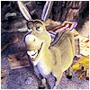
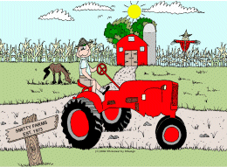
Shooting for your Goals
Dream Busters
Shake It Off and Step On It
Stay focused......Achieve your dreams
19

Slide 20
https://www.youtube.com/watch?v=q1yNI71X2nI
20

Slide 21
Shooting for your Goals
Life Situation Discussions
Situation 1: Friends
Your best friend is playing in a team against you in a Championship Final. You want your friendship to remain but feel that playing against them might ruin this.
What can you do to ensure this doesn’t spoil your friendship?
Stay focused......Achieve your dreams
21

Slide 22
Shooting for your Goals
Life Situation Discussions
Situation 2: School Project
Both you and your best friend really want to get top marks for a project your teacher has given you.
Can you both remain focused on giving the “Complete Effort” by working together but still retain your friendship?
What can you do to help achieve this?
Stay focused......Achieve your dreams
22

Slide 23
Shooting for your Goals
Life Situation Discussions
Situation 3 : Spellathon Prize
Your sisters/brothers are ringing to get sponsors for your school’s Spellathon. You want to win a special prize for the person who raises the most money. Sometimes when you ring, the donor is happy to sponsor both of you. Others only want to sponsor the person who rang. Your brothers/sisters think you should share the money.
Should you split the money?
How are you going to resolve this conflict?
Stay focused......Achieve your dreams
23

Slide 24
Championship Final
Record Ideas:
Stay focused......Achieve your dreams
24

Slide 25
School Project
Record Ideas:
Stay focused......Achieve your dreams
25

Slide 26
Spellathon Prize
Record Ideas:
Stay focused......Achieve your dreams
26

Slide 27
Your Dreams and Goals
What big Dreams and Goals do you have?
HOLD onto them...
NEVER let them go...
Don’t let “DREAM BUSTERS” rob you from achieving your dreams and goals!
Dream It
Believe It
Achieve It
Stay focused......Achieve your dreams
27

Slide 28
Kids winning in the game of life...
Can achieve their DREAMS and GOALS by staying FOCUSED
And by always trying to be “BETTER THAN BEFORE”
Stay focused......Achieve your dreams
28

