Slide 1


Winning in the Game of Life
Obeying Rules
1

Slide 2
Winning your game of life by being
BETTER THAN BEFORE in everything you do
Rules Definition
A statement that tells you what is or is not allowed in a game or situation
Live life Safely and Fairly
2

Slide 3
Winning Your Game of Life…
By obeying rules and observing boundaries
Live life Safely and Fairly
3

Slide 4



Rules in games help create
Fair Play
Safety
Live life Safely and Fairly
4

Slide 5
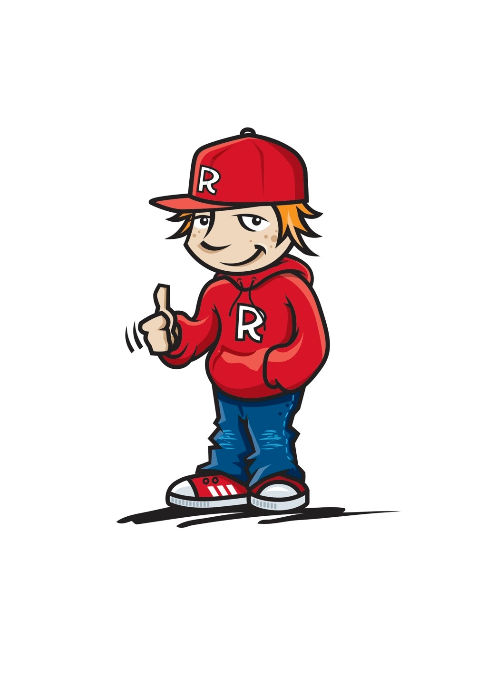
Rules
What rules do you have at school that help keep you safe?
What rules do you have at school that help create fairness?
Live life Safely and Fairly
5

Slide 6
Rules
What feelings do you have when rules are broken or you feel unfairly treated?
What are some actions you could come up with to respond to these situations?
Live life Safely and Fairly
6

Slide 7


Situation | Feelings | Suggested Actions
Live life Safely and Fairly
7

Slide 8
CLASSROOM TREATY
In our Class we are learning to be “BETTER THAN BEFORE”
We can do this by…Developing our “CLASS TREATY”
Live life Safely and Fairly
8

Slide 9
CLASSROOM TREATY
In our Class we are learning to be “BETTER THAN BEFORE”
What are some of the things we need to “DO” together in the classroom to be “BETTER THAN BEFORE”
Live life Safely and Fairly
9

Slide 10
CLASSROOM TREATY
In our Class we are learning to be “BETTER THAN BEFORE”
What are some of the things we will need to “BE” together in the classroom to be “BETTER THAN BEFORE”
Live life Safely and Fairly
10

Slide 11
CLASSROOM TREATY
Key “Doing” Words | Actions to match our “DOING” words
Live life Safely and Fairly
11

Slide 12
CLASSROOM TREATY
Key “Being” Words | Actions to match our “Being” words
Live life Safely and Fairly
12

Slide 13

OUR CLASSROOM TREATY
Come up with statements on how you will act in the classroom with your class mates.
Include both “DOING” and “BEING” statements
Once these statements are finalised create a “TREATY SIGNING” event for your class to participate in
Display your class’s Signed Treaty in a
prominent place in your classroom
Live life Safely and Fairly
13

Slide 14
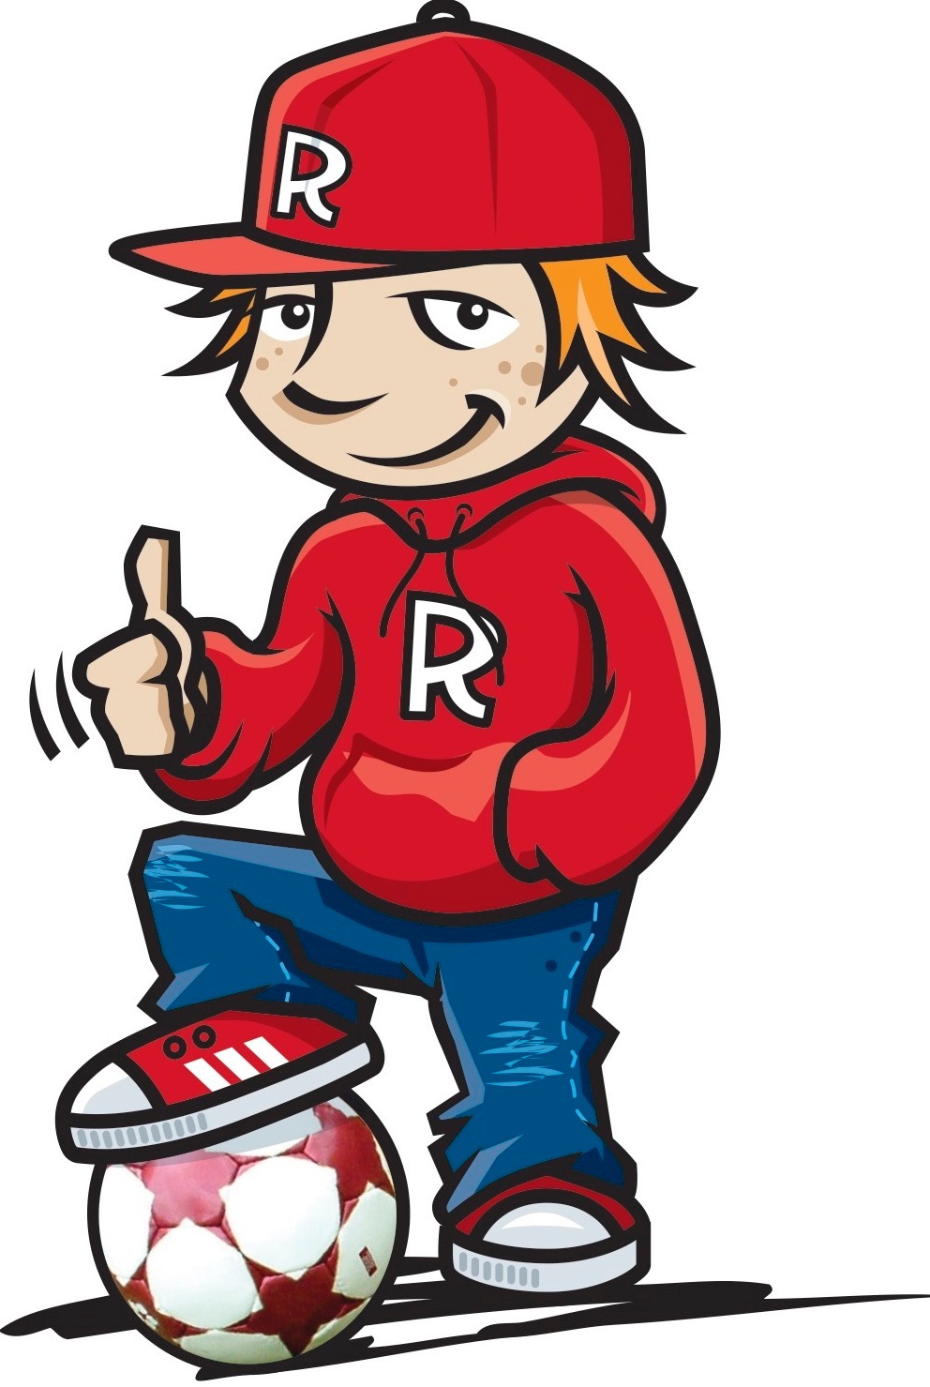
Funny Soccer Referee Video Clip
https://www.youtube.com/watch?v=EiJL04MKLDI
14

Slide 15
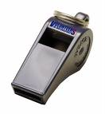
The Referee
Definition: Referees help everyone keep the rules
What is the main role of the referee?
Who acts in the role of a referee in our lives?
Live life Safely and Fairly
15

Slide 16
Questions to discuss in small groups
What are some “rules” (or ways of acting) that you could use with your
Friends
Class mates
Family
so that everyone feels included, respected and cared for?
Live life Safely and Fairly
16

Slide 17
Questions to discuss in small groups
Make a list of some of the “rules” that exist in your
classroom
family (and/or culture)
Identify which ones keep you safe and which ones create fairness
Live life Safely and Fairly
17

Slide 18
Kids winning in the game of life...
Always keep trying to be the best that they can be
Know that being part of a SAFE and FAIR community will help them to be…
“BETTER THAN BEFORE”
Live life Safely and Fairly
18

