Slide 1


Winning in the Game of Life
Achieving Your Goals
1

Slide 2
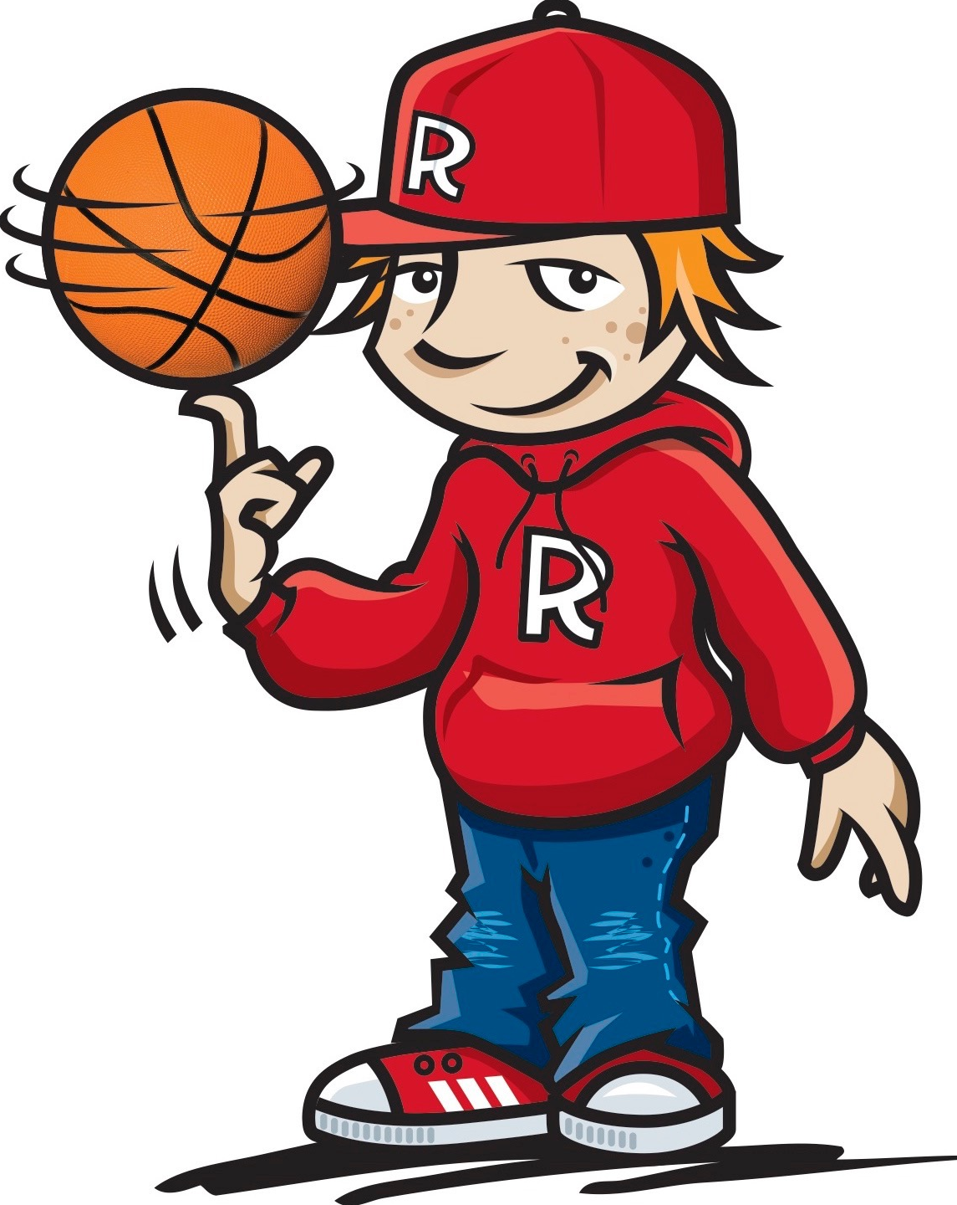
Tommy Baker Basketball Free-styler
https://www.youtube.com/watch?v=8-OluFATctM
2

Slide 3
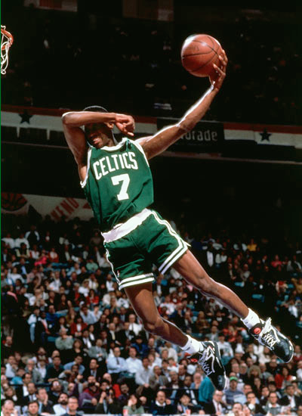
How do you think basketball players become so good?
Stay focused...Achieve your dreams
3

Slide 4

Your Dreams
What dreams do you have?
What do you want to do or be when you grow up? Why?
Stay focused...... Achieve your dreams
4

Slide 5
What can happen in a game that can take your focus away from winning the game?
What can you do to help you when this happens?
Stay focused...... Achieve your dreams
5

Slide 6




Shooting for your Goals
What kind of person do you want to “BE” with your friends?
What school goals do you want to achieve this year?
What actions will you need to take to achieve these goals?
Stay focused...... Achieve your dreams
6

Slide 7
Shooting for your Goals
My Friendship Goal by
_____________________
The goal with my friends is to
________________________
This goal is important to me because
_______________________________
_________________________________________________________________
Stay focused...... Achieve your dreams
7

Slide 8
Shooting for your Goals
My School Goal by
_____________________
I want to become better at
________________________
This goal is important to me because
_______________________________
_________________________________________________________________
Stay focused...... Achieve your dreams
8

Slide 9

Shooting for your Goals
SKILLS
An ability that helps the team to win
What skills did you need when playing “Rob the Nest?”
What skills will you need to practice to help you “Shoot for your Goals”
Stay focused...... Achieve your dreams
9

Slide 10



Shooting for your Goals
Friendship Skills
Helping you to be a
Great Friend
What are some good friendship skills?
Choose some to practice to help you achieve your Friendship Goal
Stay focused...... Achieve your dreams
10

Slide 11
Shooting for your Goals
Shooting for my “Friendship” Goal
Steps I’ll take to reach my goal are:
:
:
:
:
:
Stay focused...... Achieve your dreams
11

Slide 12

Shooting for your Goals
Skills for School
Helping you to be
great at school
1. What are some good skills you can develop for school? 2. Choose some to practice to help you achieve your School Goal
Stay focused...... Achieve your dreams
12

Slide 13
Shooting for your Goals
Shooting for my “School” Goal
Steps I’ll take to reach my goal are:
:
:
:
:
:
Stay focused...... Achieve your dreams
13

Slide 14
Shooting for your Goals
PRACTICE
A special time when you work on activities to build strength and confidence with the skills
When do you find it hard to practice the skills needed to be:
A great friend or teammate?
A great member of your school community?
Stay focused...... Achieve your dreams
14

Slide 15

Shooting for your Goals
AWARDS & TROPHIES
Awarded to a team or person who has shown improving levels of skill
What are some of the special things you have received when you practice being:
A great friend
A great member of the school community?
Stay focused...... Achieve your dreams
15

Slide 16

https://www.youtube.com/watch?v=vJG698U2Mvo
16

Slide 17

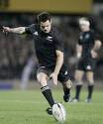






Shooting for your Goals
Staying Focused on Your Goals
Stay focused...... Achieve your dreams
17

Slide 18


Shooting for your Goals
Dream Busters
Shake It Off and Step On It
Stay focused......Achieve your dreams
18

Slide 19
https://www.youtube.com/watch?v=q1yNI71X2nI
19

Slide 20
Your Dreams and Goals
What big Dreams and Goals do you have?
HOLD onto them...
NEVER let them go...
Don’t let “DREAM BUSTERS” rob you from achieving your dreams and goals!
Stay focused...... Achieve your dreams
20

Slide 21
Kids winning in the game of life...
Can achieve their DREAMS and GOALS by staying FOCUSED
And by always trying to be “BETTER THAN BEFORE”
Stay focused......Achieve your dreams
21

