Slide 1


Winning in the Game of Life
Achieving Your Goals
1

Slide 2
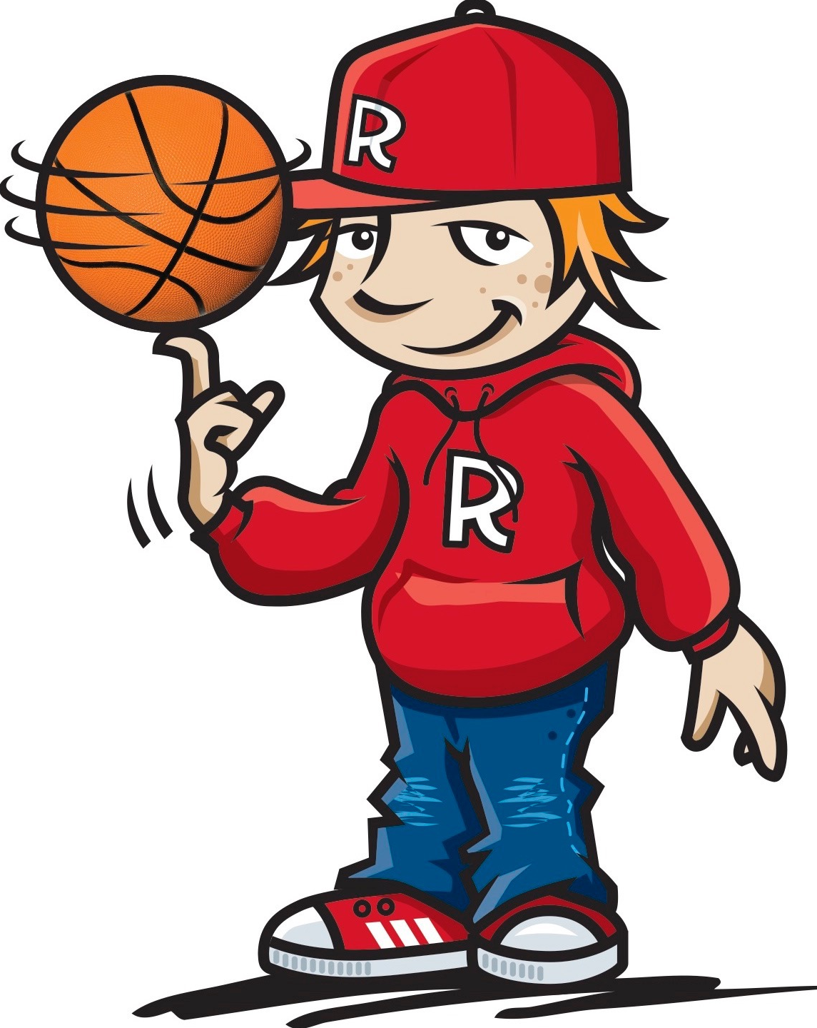
Tommy Baker Basketball Free-styler
https://www.youtube.com/watch?v=8-OluFATctM
2

Slide 3
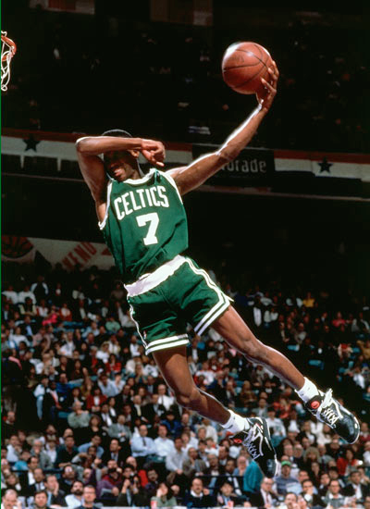
How do you think basketball players become so good?
Stay focused...Achieve your dreams
3

Slide 4

Your Dreams
What dreams do you have?
What do you want to do or be when you grow up?
Why?
Stay focused...Achieve your dreams
4

Slide 5
What can happen in a game that can take your focus away from winning the game?
What can you do to help you when this happens?
Stay focused...Achieve your dreams
5

Slide 6




Shooting for your Goals
What kind of friend do you want to be?
What actions can you take to be a good friend?
Stay focused...Achieve your dreams
6

Slide 7
Shooting for your Goals
My Friendship Goal by
_____________________
My friendship goal is
________________________
This goal is important to me because
_______________________________
_________________________________________________________________
Stay focused...... Achieve your dreams
7

Slide 8
Shooting for your Goals
My School Goal by
_____________________
I want to become better at
________________________
This goal is important to me because
_______________________________
_________________________________________________________________
Stay focused...... Achieve your dreams
8

Slide 9

Shooting for your Goals
SKILLS
An ability that helps the team to win
What skills did you need when playing “Rob the Nest?”
What skills will you need to practice to help you “Shoot for your Goals”
Stay focused...... Achieve your dreams
9

Slide 10
Shooting for your Goals
PRACTICE
A special time when you work on the skills you need to achieve your goals
To get better you need to spend time practicing your skills
What are some of the skills you might need to practice to achieve your friendship goals?
Stay focused...... Achieve your dreams
10

Slide 11
Shooting for your Goals
Shooting for my “Friendship” Goal
Steps I’ll take to reach my goal are:
:
:
:
:
:
Stay focused...... Achieve your dreams
11

Slide 12
Shooting for your Goals
Shooting for my “School” Goal
Steps I’ll take to reach my goal are:
:
:
:
:
:
Stay focused...... Achieve your dreams
12

Slide 13

https://www.youtube.com/watch?v=q1yNI71X2nI
13

Slide 14

Shooting for your Goals
Certificates and Trophies
Given to teams or individuals who
show an improving level of skill
How do you know when you are practicing being:
1. A great friend?
2. A great member of the school community?
3. A great member of your family?
Stay focused...... Achieve your dreams
14

Slide 15
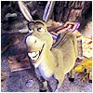
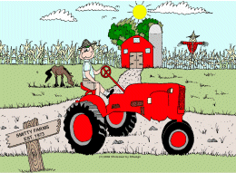
Shooting for your Goals
Dream Busters
Shake It Off and Step On It
Stay focused......Achieve your dreams
15

Slide 16
https://www.youtube.com/watch?v=vJG698U2Mvo
16

Slide 17

Your Dreams and Goals
Hold onto your DREAMS and
SHOOT for your GOALS!!
Stay focused...... Achieve your dreams
17

Slide 18
Kids winning in the game of life...
Can achieve their DREAMS and GOALS by staying FOCUSED
And by always trying to be “BETTER THAN BEFORE”
Stay focused......Achieve your dreams
18

