Slide 1




Winning Your Game of Life by having
SELF-CONTROL
1

Slide 2
Becoming a
WINNER in the
“Game of Life”
by showing
SELF-CONTROL
winning your game of life with self-control
2

Slide 3

What behaviour would you expect to see in someone with
S
E
L
F
ctrl
?
winning your game of life with self-control
3

Slide 4
S
E
L
F
ctrl
IS A CHOICE
A
G
R
E
E
o
r
D
I
S
A
G
R
E
E
winning your game of life with self-control
4

Slide 5
S
E
L
F
ctrl
To act with self control
is your choice
A
G
R
E
E
o
r
D
I
S
A
G
R
E
E
winning your game of life with self-control
5

Slide 6
Self-control means
Controlling what you...
Think
Say
Do
With your...
Friends
Classmates
Family
winning your game of life with self-control
6

Slide 7

At School
Does Self-control mean...
Being on time to class?
Doing your homework each night?
Following the teacher’s instructions?
Helping your classmates?
What other actions show self-control at school?
winning your game of life with self-control
7

Slide 8
At School
When is acting with Self-control a hard choice to make with your classmates?
Why do you think this is?
winning your game of life with self-control
8

Slide 9
Friends
When is acting with Self-control a hard choice to make with your friends?
Why do you think this is?
winning your game of life with self-control
9

Slide 10
Family
When is acting with Self-control a hard choice to make with your family?
Why do you think this is?
winning your game of life with self-control
10

Slide 11
Is it easier to act with
Self-control when adults (teachers, parents, coaches) are watching you?
Why ?
winning your game of life with self-control
11

Slide 12
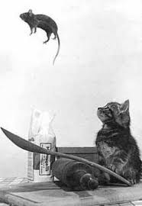
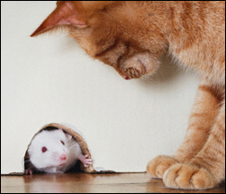
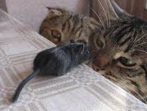
Becoming a “WINNER” at
Self-control is knowing you CAN... but deciding you WON’T
winning your game of life with self-control
12

Slide 13
Kids with put things right
Here’s How...
MUCK UP
Everyone gets things wrong at times
OWN UP
To what you’ve done wrong
PUT IT RIGHT
Think about your choices for
putting it right...
MOVE ON
After you’ve “Put It Right” Learn from your mistakes
winning your game of life with self-control
13

Slide 14

S
E
L
F
ctrl
Put it right formula
MUCK UP
OWN UP
PUT IT RIGHT
OWN UP
Choices
PUT
IT
RIGHT
Choices
Consequences...what could happen?
MOVE ON
The best choice is____________________
____________________________________
because______________________________
winning your game of life with self-control
14

Slide 15
Strengthening your
S
E
L
F
ctrl
Abide by the rules which tell you what you can and can’t do
winning your game of life with self-control
15

Slide 16
Strengthening your
S
E
L
F
ctrl
Don’t blame others....accept responsibility
winning your game of life with self-control
16

Slide 17

The Virus of Selfishness
NEEDS
V
WANTS
winning your game of life with self-control
17

Slide 18
The Virus of Selfishness
Placing your own needs ahead of others
Why do we find it hard to put the needs of others ahead of our own?
What actions by others reflect the “Virus of Selfishness”
winning your game of life with self-control
18

Slide 19
The Virus of Selfishness
Good Selfishness
V
Bad Selfishness
Is their such a thing as Good and Bad Selfishness?
winning your game of life with self-control
19

Slide 20
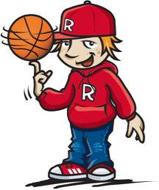
The Virus of Selfishness
Good v Bad Selfishness
Good Selfishness: Taking care of yourself
Bad Selfishness: Taking advantage of others
winning your game of life with self-control
20

Slide 21
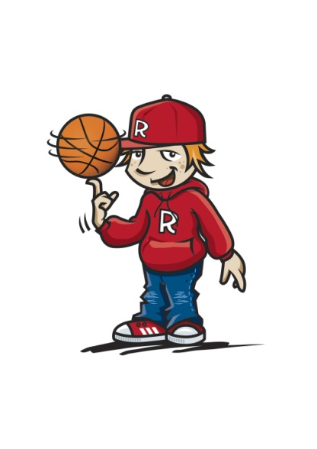
The Virus of Selfishness
Good v Bad Selfishness
Good Selfishness Taking care of yourself | Bad Selfishness Taking advantage of others
winning your game of life with self-control
21

Slide 22
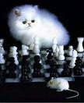
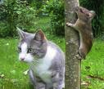
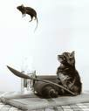

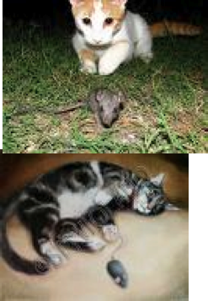
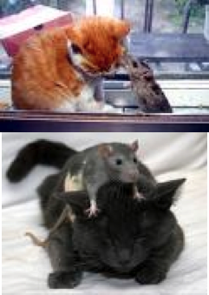
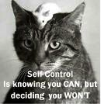
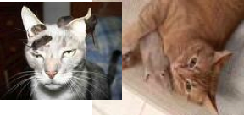
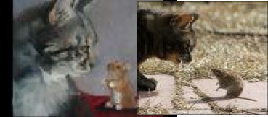
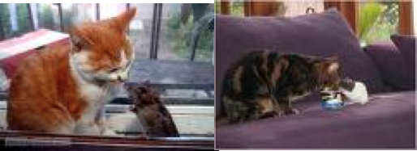
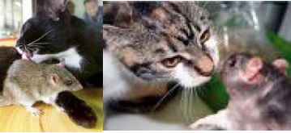
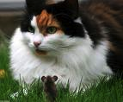

Slide 23
Becoming a “WINNER” at
S
E
L
F
ctrl
is knowing you CAN....BUT
Deciding you WONT
winning your game of life with self-control
23

Slide 24
Becoming a WINNER in “The Game of Life” means...
Acting with
winning your game of life with self-control
24

Slide 25

Learning
PATIENCE
is important in learning to act with
S
E
L
F
ctrl
winning your game of life with self-control
25

Slide 26
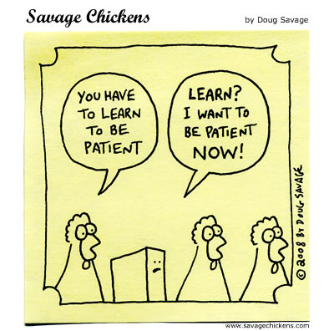

S
E
L
F
ctrl
What is patience?
winning your game of life with self-control
26

Slide 27
S
E
L
F
ctrl
PATIENCE
A willingness to accept delays
vs
Wanting what you want when you want it
winning your game of life with self-control
27

Slide 28






S
E
L
F
ctrl
http://www.youtube.com/watch?v=CsybEhP_olE ~Stupid Pigeons~ Fandub with BennyTheAsianDubber
28

Slide 29
PATIENCE
When do you find it hard to wait...
For your friends?
At school?
At home?
winning your game of life with patience
29

Slide 30

PATIENCE
Is an action!!
Learning to WAIT is an action
winning your game of life with patience
30

Slide 31

Patience in Action
When do you find it hard to wait? Why? | When? |  | Why?
What feelings do you have?
What choices do you have? What consequences could there be? | Choices . . . . .
Consequences
Decide on the BEST choice and “Do It”
The best choice is: _______________
______________________________ ______________________________
winning your game of life with patience
31

Slide 32

PATIENCE
I once learned a valuable lesson about patience. I came across a turtle on my way home from school.
winning your game of life with patience
32

Slide 33
PATIENCE
I brought him home to examine him a little more closely.
My intention was to let me go a few hours later.
winning your game of life with patience
33

Slide 34
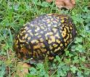
PATIENCE
I put him down and waited for him to come out of his shell.
He didn’t.
winning your game of life with patience
34

Slide 35

PATIENCE
I pulled up a chair and waited some more.
Still he didn’t move.
winning your game of life with patience
35

Slide 36

PATIENCE
I sang to the turtle.
Still no appearance.
winning your game of life with patience
36

Slide 37






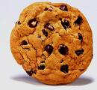

PATIENCE
I told turtle stories.
I offered him some food.
But nothing worked....
winning your game of life with patience
37

Slide 38

PATIENCE
Finally I had to leave so I barricaded the porch in case the turtle decided to leave too.
After all, I still hadn’t gotten a closer look.
winning your game of life with patience
38

Slide 39
PATIENCE
The turtle decided he had had enough. When I returned, the porch was empty. He apparently didn’t think much of my barricade.
winning your game of life with patience
39

Slide 40
PATIENCE
I learned a valuable lesson from that turtle. He just bided his time and waited.
winning your game of life with patience
40

Slide 41
PATIENCE
He wasn’t much interested in food, songs or stories. He only wanted me to go away.
So he patiently waited until I left.
Then he left too!
winning your game of life with patience
41

Slide 42
PATIENCE
What did the turtle do that showed he was patient?
Why do you think the turtle chose to act in this way?
winning your game of life with patience
42

Slide 43
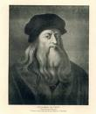
PATIENCE
“Patience serves as a protection against wrongs as clothes do against cold. For if you put on more clothes as the cold increases, it will have no power to hurt you.
winning your game of life with patience
43

Slide 44

PATIENCE
So in like manner you must grow in patience when you meet with great wrongs and they will then be powerless to vex (annoy) your mind.”
Leonardo do Vinci, painter, engineer, musician and scientist (1452 - 1519)
winning your game of life with patience
44

Slide 45
IMPATIENCE is...
wanting things
NOW!!
winning your game of life with patience
45

Slide 46
IMPATIENCE is...wanting things now
What does WAITING
feel like?
look like?
sound like?
winning your game of life with patience
46

Slide 47
IMPATIENCE The opposite to Patience
What are some of the things you find yourself getting impatience over...
With your friends?
In the classroom?
In the playground at lunchtime?
winning your game of life with patience
47

Slide 48
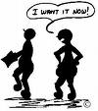

Developing my Patience
 | I get impatient when I... | Ideas for what I can do next time
Friends
School
At Home
winning your game of life with patience
48

Slide 49
IMPATIENCE
Learning to take turns
Patient people learn to take turns
When do you need to learn to take turns with...
Your friends
In class
In the playground at lunchtime
With your brothers, sisters or cousins
winning your game of life with patience
49

Slide 50

IMPATIENCE
The opposite to Patience
Patient people learn to take turns
What ideas can you come up with to help sort out situations when others always want things their way?
winning your game of life with patience
50

Slide 51
IMPATIENCE
Taking Turns
By: Jacqueline Jules
Last night I stood watching
as colours spread across the sky.
Once again, the sun was setting.
Once again, I wondered why.
They say the earth is spinning
every second, round and round.
Why don’t I feel it moving
when I’m standing on the ground?
winning your game of life with patience
51

Slide 52
IMPATIENCE
They say when evening comes
and I brush my teeth for bed,
children way across the globe
are waking up instead.
Could that be the reason
we lose the sun each night?
The world is taking turns.
I think that's quite polite.
winning your game of life with patience
52

Slide 53

IMPATIENCE
Why does this caterpillar need to show patience?
PATIENCE requires us to wait...
winning your game of life with patience
53

Slide 54


54

Slide 55
IMPATIENCE
Hurts Friendships
Impatience with others makes us more critical of others and hurts friendships
Has this ever happened to you?
winning your game of life with patience
55

Slide 56
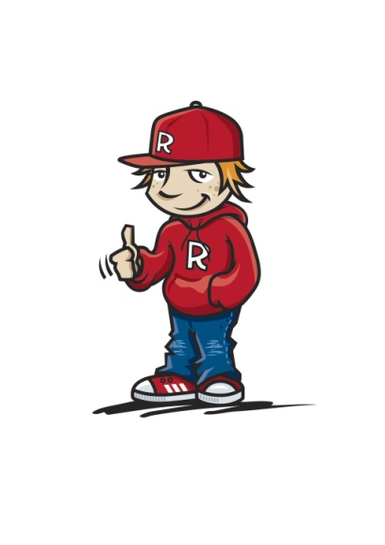
Developing Great Friendships
 | My friendship was hurt when I... | Ideas for what I can do next time
Friends
School
winning your game of life with patience
56

Slide 57
Becoming a
WINNER
in the
“Game of Life”
Requires
PATIENCE
By learning to
WAIT
winning your game of life with patience
57

Slide 58



Quick REACTIONS
What are some of the things we SAY when we “erupt?”
What are some of the things we DO when we “erupt?”
S
E
L
F
ctrl
58

Slide 59
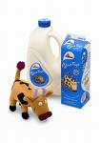



Slow REACTION
What are some of the words to describe this reaction ?
S
E
L
F
ctrl
59

Slide 60

Quick REACTION
Slow REACTION
What are some of the main differences between quick & slow reactions
S
E
L
F
ctrl
60

Slide 61
Slow v Quick REACTIONS
Would you expect to see slow or quick reactions if they are people with...
S
E
L
F
ctrl
winning your game of life with slow reactions
61

Slide 62

People who REACT slowly
show GREAT
SELF CONTROL
They use TIME to THINK
about what to…
SAY and DO
winning your game of life with slow reactions
62

Slide 63

People who REACT slowly
show GREAT
SELF CONTROL
Words like Toothpaste
can’t be put back!!
winning your game of life with slow reactions
63

Slide 64
Thinking before you act helps you to respond to difficult situations peacefully
Agree or Disagree?
Can you think of times when this advice may help you?
winning your game of life with slow reactions
63

Slide 65
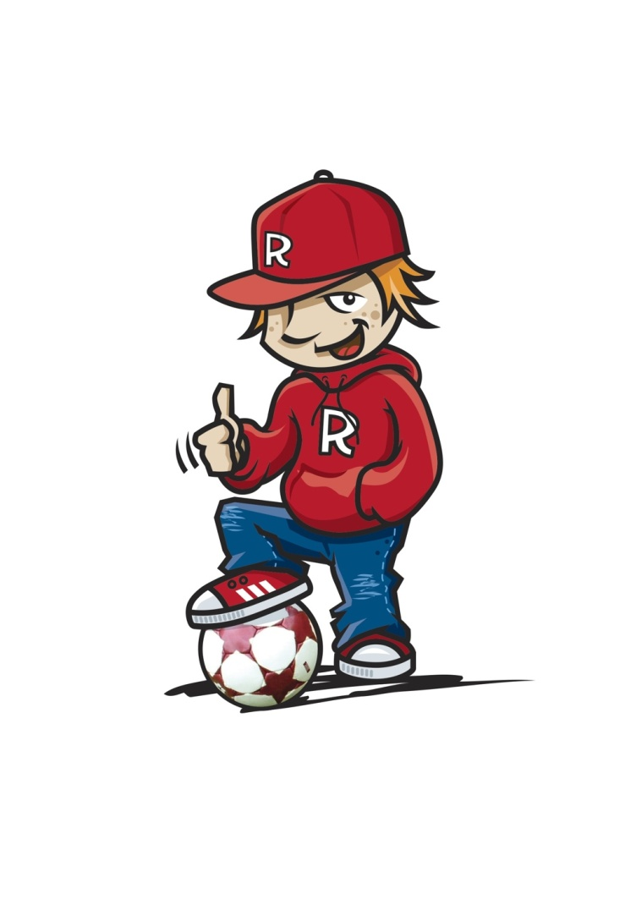
“People who show
SELF CONTROL
by thinking about what to
SAY & DO
are not easily provoked!”
Why do you think that is?
winning your game of life with slow reactions
65

Slide 66
Thinking about what to SAY & DO when annoyed
Situations that annoy me... | What I can SAY next time | What I can DO next time
winning your game of life with Slow Reactions
66

Slide 67


REACTING to making mistakes
Who has made
MISTAKES?
What are some feelings you have when you make mistakes?
winning your game of life by fixing mistakes
67

Slide 68
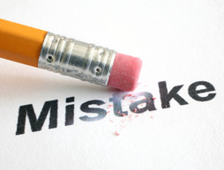

REACTING
to making mistakes
How do you feel when you give a wrong answer in class?
Did you know that you are more likely to remember the correct answer when you’ve given a wrong one!!
winning your game of life by fixing mistakes
68

Slide 69
REACTING to making mistakes
Fixing mistakes
Did it...
Hurt yourself or anyone else?
Make you feel embarrassed?
Make you feel frustrated?
Come up with a “Game Plan” to improve the situation
winning your game of life by fixing mistakes
69

Slide 70
REACTING to mistakes
My Game Plan
When I hurt someone I can...
When I feel embarrassed I can...
When I feel frustrated I can...
winning your game of life by fixing mistakes
70

Slide 71


REACTING
to making mistakes
Every mistake is a chance to learn something new
Remember you’re not the first person to make a mistake
winning your game of life by fixing mistakes
71

Slide 72

REACTING
to making mistakes
Mistakes are 1 step closer to success
Agree or Disagree?
winning your game of life by fixing mistakes
72

Slide 73
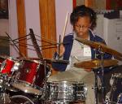
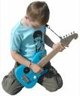


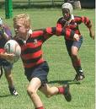


REACTING
to making mistakes by...
Giving things a GO again!!
What are some things that you have been put off trying again?
winning your game of life by fixing mistakes
73

Slide 74
Becoming a WINNER
in the game of life
Means to...
GIVE THINGS A GO
Even when you make a MISTAKE
winning your game of life with slow reactions
74

Slide 75

Becoming a WINNER
in the game of life
Requires
SLOW REACTIONS
By learning to
THINK
about what to
SAY
and DO
winning your game of life with slow reactions
75

Slide 76
Self Control Review
Patience
means
Waiting
Slow Reactions
gives us
Thinking Time to think about...
What to say
and
What to do
winning your game of life with slow reactions
76

Slide 77
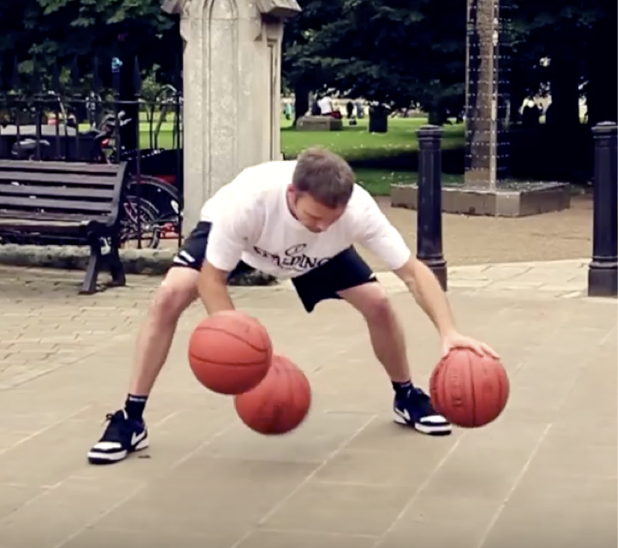
https://www.youtube.com/watch?v=l5rtBYYQhEs
77

Slide 78
Discipline
What parts of his body did he use to
control the ball?
Does the ball need to be moving to have control?
How do you think he became so good
at doing tricks with the balls?
Why do you think he might want to become
really good at these tricks??
winning your game of life with discipline
78

Slide 79

Discipline
Definitions include:
Ability to follow instructions
Respect for authority
Doing what’s right even when others aren’t looking
winning your game of life with discipline
79

Slide 80

DISCIPLINE
The bridge
between “GOALS” &
ACCOMPLISHMENTS
winning your game of life with discipline
80

Slide 81

The first person to discipline is...
YOURSELF
winning your game of life with discipline
81

Slide 82

Disciplining yourself
is called...
SELF-DISCIPLINE
Definition: Doing certain tasks even when you don’t feel like it!!
winning your game of life with discipline
82

Slide 83
Disciplining yourself
is called...
SELF-DISCIPLINE
Definition: Doing what you know is best and doing it gladly v just doing what you want
winning your game of life with discipline
83

Slide 84
SELF-DISCIPLINE
How much Self-Discipline do you have?
Answer yes or no to these statements
Shower or bathe everyday
Get up in time to not be rushed or arrive late to school
Go to bed at a set time each night
winning your game of life with discipline
84

Slide 85
SELF-DISCIPLINE
Answer yes or no to these statements
Your bed is made and your room neat
Your desk or tote tray at school is tidy
You keep your promises
You play outside more than watching TV or playing on the computer
winning your game of life with discipline
85

Slide 86
SELF-DISCIPLINE
Answer yes or no to these statements
You finish homework on time
You stay on task at school and aren’t easily distracted
Your appearance is neat and tidy ie hair tidy and clothes neat
Your lunch box has more freshly made food than packaged food
winning your game of life with discipline
86

Slide 87
SELF-DISCIPLINE
Answer yes or no to these statements
You have a book that you are reading
If you get pocket money you save some instead of spending it
Count up how many yes vs no answers you have!!
winning your game of life with discipline
87

Slide 88
DISCIPLINE
SELF-DISCIPLINE
If you have more YES than NO answers you have good SELF-DISCIPLINE!!
winning your game of life with discipline
88

Slide 89
Building up my SELF-DISCIPLINE
By setting some goals and designing a “Game Plan”
Set small achievable “Action Steps”
winning your game of life with discipline
89

Slide 90
My Game Plan
My Personal Goal is to.... I want to achieve this by...
My action steps are... (Remember to make them small and achievable)
This week my action step is...
I am going to do my action steps on...
winning your game of life with discipline
90

Slide 91
Building up my SELF-DISCIPLINE
I can build up my SELF-DISCIPLINE by...
Using my “WILLPOWER”
winning your game of life with discipline
91

Slide 92
Building up my SELF-DISCIPLINE
Willpower is your ability to just
“DO IT!!”
winning your game of life with discipline
92

Slide 93

Building up my SELF-DISCIPLINE
“WILLPOWER”
acts like a “Rocket Booster” to get you started
It gives you short powerful bursts
winning your game of life with discipline
93

Slide 94

94

Slide 95
Building up my SELF-DISCIPLINE
by being ACCOUNTABLE
Share your “Game Plan” with your parents or a friend and add it to your homework
Cross off action steps when you’ve done each one
winning your game of life with discipline
95

Slide 96
Building up my SELF-DISCIPLINE
by Putting in the Time
Accept it...Get it done...Don’t whine.....or make excuses..just
”DO IT”
winning your game of life with discipline
96

Slide 97
Building up my SELF-DISCIPLINE
by being Persistent
If you keep taking action you will get results
RESULTS come from ACTION and that leads to SUCCESS
winning your game of life with discipline
97

Slide 98

A person acting with
DISCIPLINE
is showing...
SELF CONTROL
winning your game of life with discipline
98

Slide 99
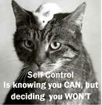
“SELF CONTROL is a
C H O I C E ”
That CHOICE is YOURS
winning your game of life with self-control
99

Slide 100
S
E
L
F
ctrl
Review
Patience
means learning to
WAIT
Wanting it
NOW!!
v
winning your game of life with patience
100

Slide 101
S
E
L
F
ctrl
Review
SLOW REACTIONS
gives you time to
THINK about what to
SAY
&
DO
winning your game of life with slow reactions
101

Slide 102
S
E
L
F
ctrl
Review
DISCIPLINE
The bridge between your
GOALS
and
ACHIEVING THEM
winning your game of life with discipline
102

Slide 103

Becoming a WINNER in the
“Game of Life”
means to act with
S
E
L
F
ctrl
by
Showing PATIENCE
REACTING slowly
and showing DISCIPLINE
winning your game of life with self-control
103

