Slide 1




Winning Your Game of Life by having
SELF-CONTROL
1

Slide 2
Becoming a
WINNER in the
“Game of Life”
by showing
SELF-CONTROL
winning your game of life with self-control
2

Slide 3

What behaviour would you expect to see in someone with
S
E
L
F
ctrl
?
winning your game of life with self-control
3

Slide 4
S
E
L
F
ctrl
IS A CHOICE
A
G
R
E
E
o
r
D
I
S
A
G
R
E
E
winning your game of life with self-control
4

Slide 5
S
E
L
F
ctrl
To act with self control
is your choice
A
G
R
E
E
o
r
D
I
S
A
G
R
E
E
winning your game of life with self-control
5

Slide 6
Self-control means
Controlling what you...
Think
Say
Do
With your...
Friends
Classmates
Family
winning your game of life with self-control
6

Slide 7
At School
Does this mean...
Being on time to class?
Doing your homework?
Following instructions?
winning your game of life with self-control
7

Slide 8
At School
Does this mean...
Waiting for others?
Helping your classmates?
What other actions show
“Self-Control” at school?
winning your game of life with self-control
8

Slide 9
S
E
L
F
ctrl
What actions show Self-Control....
With friends?
At home?
winning your game of life with self-control
9

Slide 10
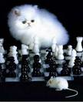
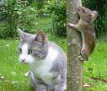
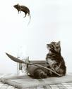

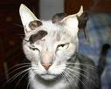



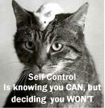

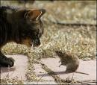
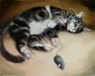
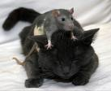


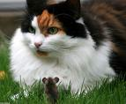



10

Slide 11
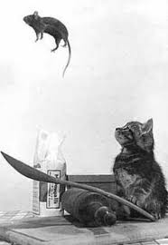
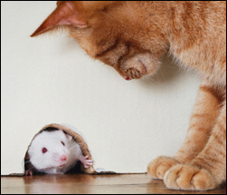
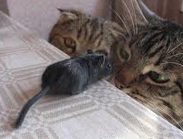
Becoming a “WINNER” at
Self-Control is knowing you CAN... but deciding you WON’T
winning your game of life with self-control
11

Slide 12

Is acting with
SELF-CONTROL easier when the teacher is present?
Why ?
winning your game of life with self-control
12

Slide 13

What actions show
S
E
L
F
ctrl
How can you help others to act with Self-Control when the teacher isn’t there?
winning your game of life with self-control
13

Slide 14


13

Slide 15
Did the fox show
SELF-CONTROL ?
Self-Control for different reasons
Self-Control for yourself (Self Interest)
v
Self-Control that helps others
winning your game of life with self-control
15

Slide 16

Kids with put things right
Here’s How...
MUCK UP
Everyone gets things wrong at times
OWN UP
To what you’ve done wrong
PUT IT RIGHT
Think about your choices for
putting it right...
MOVE ON
After you’ve “Put It Right” Learn from your mistakes
winning your game of life with self-control
16

Slide 17
Becoming a WINNER in the
“The Game of Life”
means...
Acting with
By having...
winning your game of life with self-control
17

Slide 18

PATIENCE
What is patience?
winning your game of life with patience
18

Slide 19






S
E
L
F
ctrl
http://www.youtube.com/watch?v=CsybEhP_olE ~Stupid Pigeons~ Fandub with BennyTheAsianDubber
winning your game of life with patience
19

Slide 20
S
E
L
F
ctrl
PATIENCE
Learning to WAIT
v
Wanting something
NOW!!
winning your game of life with patience
20

Slide 21

PATIENCE
I once learned a valuable lesson about patience. I came across a turtle on my way home from school.
winning your game of life with patience
21

Slide 22
PATIENCE
I brought him home to examine him a little more closely.
My intention was to let me go a few hours later.
winning your game of life with patience
22

Slide 23
PATIENCE
I put him down and waited for him to come out of his shell.
He didn’t.
winning your game of life with patience
23

Slide 24

PATIENCE
I pulled up a chair and waited some more.
Still he didn’t move.
winning your game of life with patience
24

Slide 25

PATIENCE
I sang to the turtle.
Still no appearance.
winning your game of life with patience
25

Slide 26






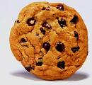

PATIENCE
I told turtle stories.
I offered him some food.
But nothing worked....
winning your game of life with patience
26

Slide 27

PATIENCE
Finally I had to leave so I barricaded the porch in case the turtle decided to leave too.
After all, I still hadn’t gotten a closer look.
winning your game of life with patience
27

Slide 28
PATIENCE
The turtle decided he had had enough. When I returned, the porch was empty. He apparently didn’t think much of my barricade.
winning your game of life with patience
28

Slide 29
PATIENCE
I learned a valuable lesson from that turtle. He just bided his time and waited.
winning your game of life with patience
29

Slide 30
PATIENCE
He wasn’t much interested in food, songs or stories. He only wanted me to go away.
So he patiently waited until I left.
Then he left too!
winning your game of life with patience
30

Slide 31
PATIENCE
What did the turtle do that showed he was patient?
Why do you think the turtle chose to act in this way?
winning your game of life with patience
31

Slide 32

PATIENCE
Is an action!!
Learning to WAIT is an action
winning your game of life with patience
32

Slide 33

PATIENCE
is learning to wait
Sometimes at home we
need to learn to wait
Wait a minute!!
winning your game of life with patience
33

Slide 34
PATIENCE
is learning to wait
Sometimes at home we
need to learn to wait
I only have 2 hands
winning your game of life with patience
34

Slide 35
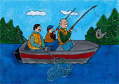
PATIENCE
is learning to wait
When do you find it
hard to wait ?
winning your game of life with patience
35

Slide 36
PATIENCE
is learning to wait
What feelings do you have
when you have to wait ?
winning your game of life with patience
36

Slide 37

Patience in Action
When do you find it hard to wait?
What feelings do you have?
What choices do you have? What consequences could there be? | Choices . . . .
Consequences
The best choice is:__________________________ _______________________________________________________________________________________________________________________________________
Decide on the BEST choice and “Do It”
winning your game of life with patience
37

Slide 38

PATIENCE
When do you take turns at school?
Is it fair to take turns?
WHY?
winning your game of life with patience
38

Slide 39
IMPATIENCE
is the opposite to Patience
IMPATIENCE
is wanting things...
NOW!!
winning your game of life with patience
39

Slide 40
IMPATIENCE
NOW!!
is wanting things...
What does IMPATIENCE
feel like?
look like?
sound like?
winning your game of life with patience
40

Slide 41
PATIENCE
is WAITING for things...
What does PATIENCE
feel like?
look like?
sound like?
winning your game of life with patience
41

Slide 42
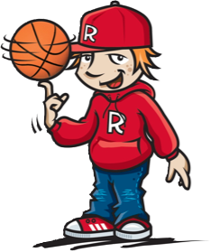
IMPATIENCE
NOW!!
is wanting things...
Sometimes you need to WAIT
for help in the classroom
winning your game of life with patience
42

Slide 43
PATIENCE
is WAITING for things...
What can you DO
while you are WAITING in the classroom?
winning your game of life with patience
43

Slide 44
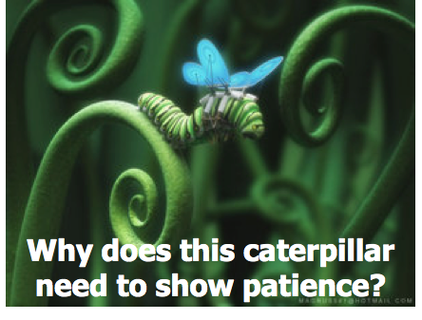
IMPATIENCE
is wanting things...
NOW!!
winning your game of life with patience
44

Slide 45

45

Slide 46

Becoming a WINNER in the
“Game of Life”
Requires
PATIENCE
WAIT
By learning to
winning your game of life with patience
46

Slide 47



Quick REACTIONS
What are some of the things we DO when we “erupt?”
What are some of the things we SAY when we “erupt?”
S
E
L
F
ctrl
47

Slide 48
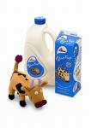



Slow REACTION
What are some of the words to describe this reaction ?
S
E
L
F
ctrl
48

Slide 49

Quick REACTION
Slow REACTION
What are some of the main differences between quick & slow reactions
S
E
L
F
ctrl
49

Slide 50

Slow v Quick REACTIONS
Would you expect to see slow or quick reactions if they are people with...
S
E
L
F
ctrl
winning your game of life with slow reactions
50

Slide 51


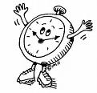


People who REACT slowly
Use TIME to THINK
about what to...
SAY
and DO
winning your game of life with slow reactions
51

Slide 52

Slow REACTIONS
Words are like Toothpaste
They can’t be put back!
winning your game of life with slow reactions
52

Slide 53


REACTIONS to making mistakes
Who has made
MISTAKES?
What are some feelings you have when you make mistakes?
Reacting to mistakes positively
55

Slide 54
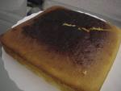
Peggy’s Cake
Peggy cried as she took the burnt cake out of the oven.
"I burnt the cake," Peggy replied unhappily.
Her mother, hearing her cry, came into the kitchen, saw the cake and said,
“What happened?”
"I burnt the cake."
Reacting to mistakes positively
54

Slide 55
Peggy’s Cake
"I can see that. Let's find out what happened," her mother said as she put her arm around the distressed girl.
"I know you didn't do it on purpose, and I can see you feel badly about it.
Dry your eyes and let's read the recipe together."
Reacting to mistakes positively
55

Slide 56
Peggy’s Cake
Peggy and her mother read over the recipe and found that the temperature control on the oven had been set too high.
"Now that we know what went wrong," her mother said, "Let's wash the dishes and you can try again."
Reacting to mistakes positively
56

Slide 57

REACTIONS to making mistakes
What did Peggy’s mother SAY to help her?
What did Peggy’s mother DO to help her?
Reacting to mistakes positively
57

Slide 58
REACTIONS to making mistakes
What was the main mistake Peggy made?
How could this help Peggy be successful next time?
Reacting to mistakes positively
58

Slide 59
REACTIONS to making mistakes
Do you think Peggy should have another go now?
Why?
Why do you think Peggy will be successful next time?
Reacting to mistakes positively
59

Slide 60

REACTIONS to making mistakes
Mistakes are 1 step closer to success
Agree or Disagree?
winning your game of life even when you make a mistake
60

Slide 61

REACT to mistakes by...
GIVING things a GO again!
What sometimes stops you from giving things a go again?
winning your game of life by giving things a go
61

Slide 62

Becoming a WINNER
in the game of life
means to...
GIVE THINGS A GO
Even when you make a MISTAKE
becoming a champion by giving things a go
62

Slide 63
Becoming a WINNER
in the game of life
Requires
SLOW REACTIONS
By learning to
THINK
about what to
SAY
and DO
63

Slide 64

Self-Control Review
Patience
means
Waiting
Slow Reactions
gives us
Thinking Time to think about...
What to say and
What to do
winning your game of life with self-control
64

Slide 65
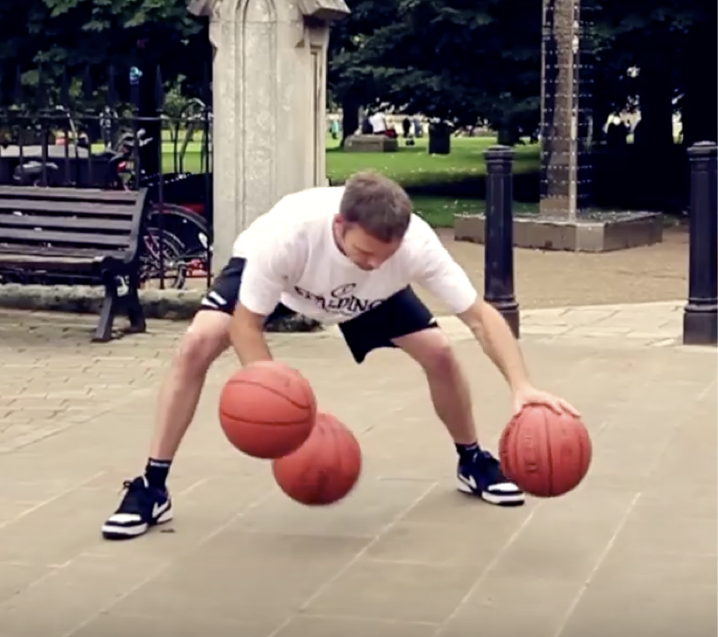
https://www.youtube.com/watch?v=l5rtBYYQhEs
65

Slide 66
DISCIPLINE
What parts of his body did he use to
control the ball?
Does the ball need to be moving to have control?
How do you think he became so good
at doing tricks with the balls?
Why do you think he might want to become really good at these tricks??
winning your game of life with discipline
66

Slide 67


DISCIPLINE
DISCIPLINE
The bridge
between “GOALS” &
ACCOMPLISHMENTS
The bridge
between GOALS &
ACCOMPLISHMENTS
68

Slide 68
DISCIPLINE
“DISCIPLINE” is about WORKING HARD
What is something you are really proud of doing?
The bridge
between “GOALS” &
ACCOMPLISHMENTS
Do you always feel like practicing?
winning your game of life with discipline
68

Slide 69
Achieving Goals with DISCIPLINE
DISCIPLINE
What is a “GOAL” you would really
like to achieve?
What will you have to work hard at to achieve this GOAL?
DISCIPLINE is working hard even
when you don’t feel like it
winning your game of life with discipline
69

Slide 70
DISCIPLINE
DISCIPLINE
The key that unlocks success
The bridge
between “GOALS” &
ACCOMPLISHMENTS
Agree or Disagree?
Why?
winning your game of life with discipline
70

Slide 71
DISCIPLINE
work hard
have fun
make a difference
Learning to work hard helps us to be DISCIPLINED
winning your game of life with discipline
71

Slide 72
DISCIPLINE
Work hard
Have fun
Make a difference
Can you have fun when you work hard?
winning your game of life with discipline
72

Slide 73
DISCIPLINE
DISCIPLINE
The first person
to discipline is...
YOURSELF
73

Slide 74

DISCIPLINE
Disciplining yourself
is called
SELF-DISCIPLINE
I am showing Self-Discipline with my friends when I...
winning your game of life with discipline
74

Slide 75
DISCIPLINE
Disciplining yourself
is called
SELF-DISCIPLINE
I am showing Self-Discipline in class when I...
winning your game of life with discipline
75

Slide 76
DISCIPLINE
Disciplining yourself
is called
SELF-DISCIPLINE
I am showing Self-Discipline at home when I...
winning your game of life with discipline
76

Slide 77
SELF-DISCIPLINE
means I don’t make excuses
Everyone makes excuses
Why?
winning your game of life with discipline
77

Slide 78
SELF-DISCIPLINE
means I don’t make excuses
What are some things you make excuses for...
At school?
With your friends?
At home?
winning your game of life with discipline
78

Slide 79
Building up my SELF-DISCIPLINE
I can build up my SELF- DISCIPLINE by...
Doing things I don’t always want to do
winning your game of life with discipline
79

Slide 80
Building up my SELF-DISCIPLINE
What can you do in class to build up your SELF-DISCIPLINE
so it will be a GREAT place for learning?
winning your game of life with discipline
80

Slide 81
Building up my SELF-DISCIPLINE
How can you build up SELF-DISCIPLINE with your friends so you can be a GREAT friend?
winning your game of life with discipline
81

Slide 82
Building up my SELF-DISCIPLINE
What can you do at home to build up your SELF-DISCIPLINE?
winning your game of life with discipline
82

Slide 83
A person acting with
DISCIPLINE
is showing...
SELF-CONTROL
winning your game of life with self-control
83

Slide 84
“SELF-CONTROL is a
C H O I C E ”
That CHOICE is YOURS
winning your game of life with self-control
84

Slide 85
S
E
L
F
ctrl
Review
Patience
means learning to
WAIT
Wanting it
NOW!!
v
winning your game of life with patience
85

Slide 86
S
E
L
F
ctrl
Review
SLOW REACTIONS
gives you time to
THINK about what to
SAY
and
DO
winning your game of life with slow reactions
86

Slide 87
S
E
L
F
ctrl
Review
DISCIPLINE
The bridge between your
GOALS
and
ACHIEVING THEM
winning your game of life with discipline
89

Slide 88
Becoming a WINNER in the “Game of Life”
means to act with SELF-CONTROL
by
REACTING slowly
Showing PATIENCE
Showing DISCIPLINE
winning your game of life with self-control
88

