Slide 1




Winning Your Game of Life by
Being Focused
1

Slide 2
Focus
Definition
To bring into the centre of attention
Focus your attention
2

Slide 3
Focus
What is an optical illusion?
Optical illusions are interesting pictures which need to be viewed with FOCUS
They seem to our eyes to be something which they are not
Focus your attention
3

Slide 4

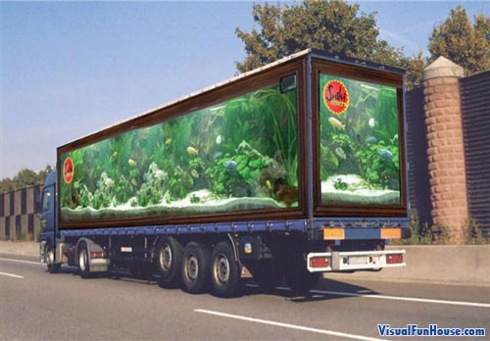
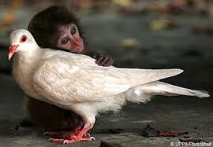
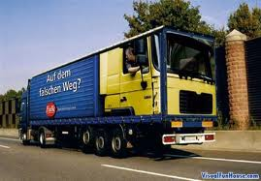
Focus
What’s odd about these pictures?
https://www.youtube.com/watch?v=FxMCzytL0k8
Focus your attention
4

Slide 5
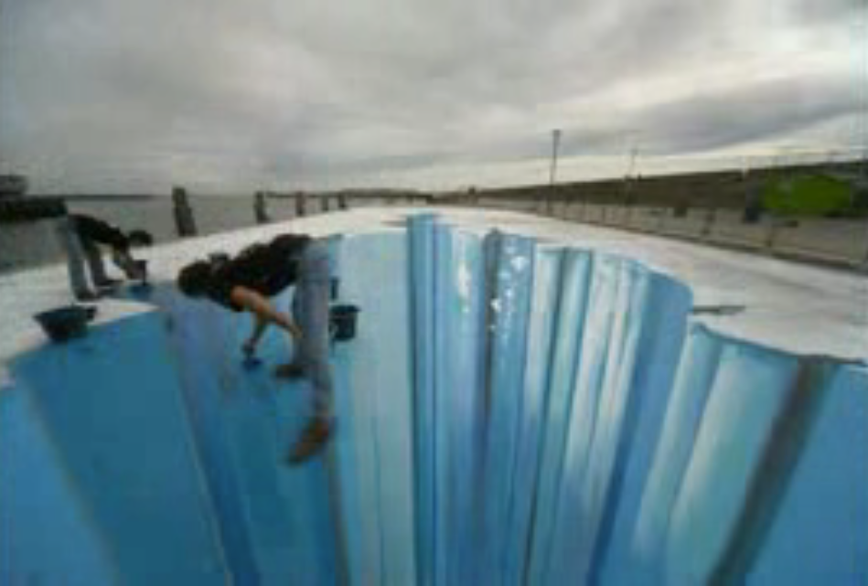
http://www.dailymotion.com/video/xj7es3_mind-your-step-optical-illusion-street-art_creation
https://www.youtube.com/watch?v=3SNYtd0Ayt0
4
5

Slide 6
Focus
What’s odd about this picture?
Focus your attention
6

Slide 7
Focus
Focus on the dot in the middle and move your head forward and back
Focus your attention
7

Slide 8
Focus
What happens when you focus on this picture?
Focus your attention
8

Slide 9
Focus
Which of these figures is the tallest?
Focus your attention
9

Slide 10
Focus
What do you see here?
Focus your attention
10

Slide 11
Focus
2 areas to FOCUS on
Yourself
Others
Creating a positive outlook
A focus on the needs of others
11

Slide 12
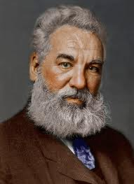

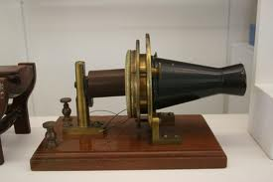
A Focus on the Needs of Others
  “Concentrate all your thoughts upon the work at hand. The sun's rays do not burn until brought to a focus.”
  Alexander Graham Bell
What do you think he means by this?
Focus your attention on the needs of others
12

Slide 13
A Focus on the Needs of Others
  Alexander Graham Bell is a great example of someone who lived his life focusing on the needs of others.
  Alexander Graham Bell
  Find out about his inventions and the story behind them.
Focus your attention on the needs of others
13

Slide 14

Focus on the Positive
Accentuate the Positive
“You can always choose to perceive things differently.
You can focus on what's wrong, or you can focus on what's right.”
Marianne Williamson
What do you think the author means?
Focus your attention on the positive
14

Slide 15
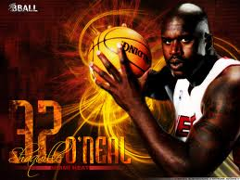
Focus on the Positive
Accentuate the Positive
“We know that we're supposed to win all the games, but if we don't, we just have to take the next game and focus on what we did wrong in the game before and just try to do better at the next game.”
Shaquille O'Neal
Focus your attention on the positive
15

Slide 16
Focus on the Positive
Accentuate the Positive
How can you use this advice and apply it to other areas of your life?
Focus your attention on the positive
16

Slide 17

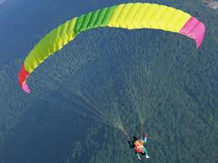
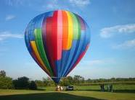
Focus on the Positive
Accentuate the Positive
A positive mind is not an accident. It’s something you do on purpose.
You can create a positive mind, if you focus on the positive things.
Focus your attention on the positive
17

Slide 18

A Focus on Others
Brainstorm Relay
What does being kind mean?
Being kind means…
18

Slide 19
A Focus on Others
Become a bucket filler
What can you do to fill other people’s buckets?
19

Slide 20

Become a bucket filler not a bucket dipper
Being nice makes you feel better too
https://www.youtube.com/watch?v=Vrd0lmQnBTw
20

Slide 21
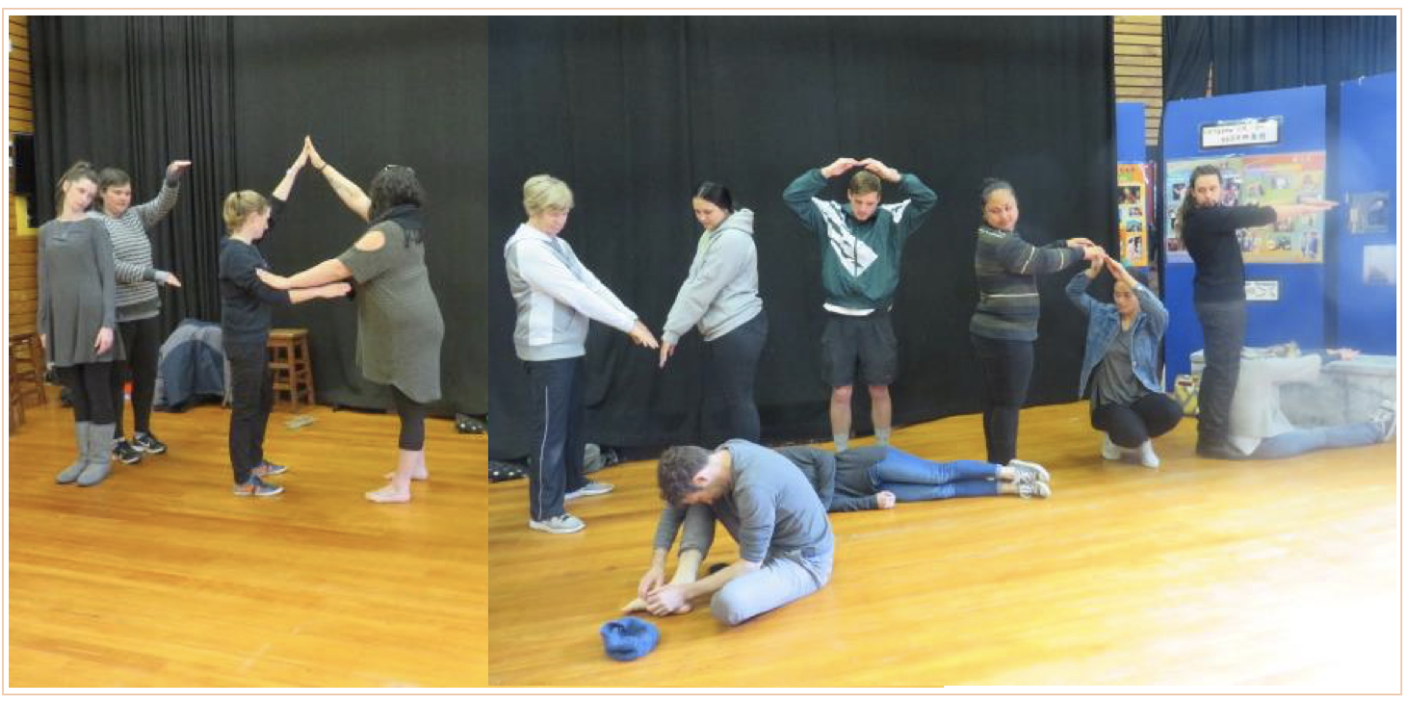
A Focus on Others
Kindness
21

Slide 22
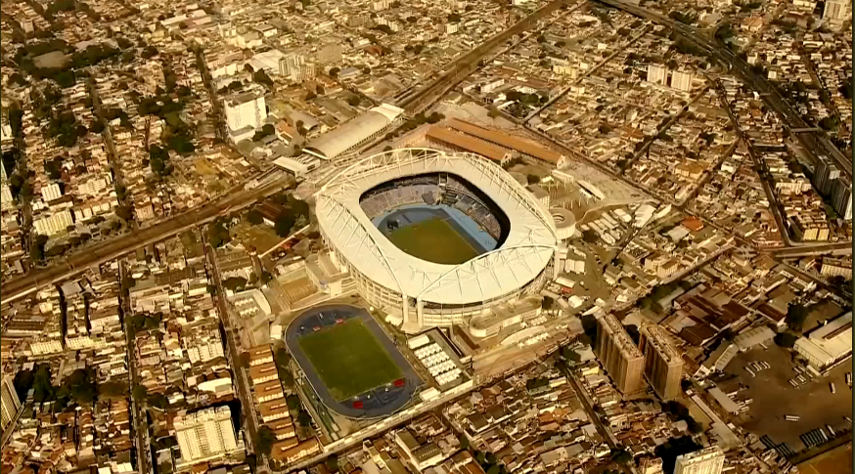
Love and kindness are never wasted…they always make a difference Agree or disagree? Why?
What difference did kindness make here?
https://www.youtube.com/watch?v=dCVlRFWOjgE
22

Slide 23
A Focus on Others
What does kindness mean to you?
23

Slide 24
A Focus on Others
The 5 Day Bucket Filling Class Challenge
Monday | Tuesday | Wednesday | Thursday | Friday
What can you do this week to make a positive difference in your classroom?
24

Slide 25
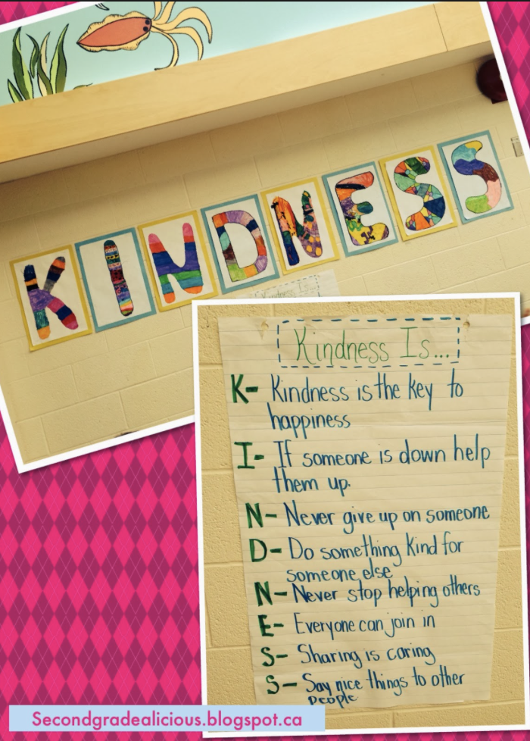
A Focus on Others
What does kindness mean to you?
Create a video that explains what kindness means
25

Slide 26
A Focus on Others
The 5 Day Bucket Filling Family Challenge
Monday | Tuesday | Wednesday | Thursday | Friday
As a family come up with 5 ways you can practice filling everyone’s buckets at home
26

Slide 27
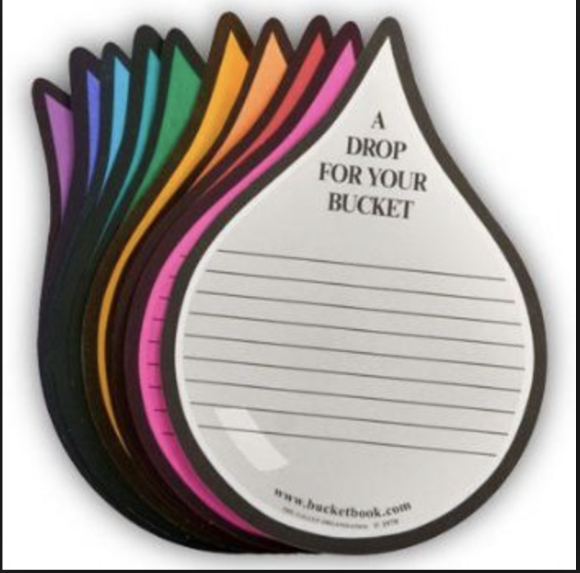
A Focus on Others
No act of kindness is ever too small Author unknown
Compliment Circle Starters
I think you…
You are…
I like the way you…
Thank you for…
You are good at…
You worked really hard at
Good job showing…
It was nice of you to…
You were a good friend when you…
27

Slide 28
A Focus on Self
You are one of a kind!
No one on earth exists quite like you!
28

Slide 29
A Focus on Self
Uniquely You
Arch
Loop
Whorl
Thumbprint Patterns
Focus on yourself...you are unique
29

Slide 30

A Focus on Self
Uniqueness
Definition
You are 1 of a kind
You are the only one
Focus on yourself...you are unique
30

Slide 31

A Focus on Self
U R Unique
Rip a piece of paper into 10 strips
On each strip write a word or phrase that describes you
Focus on yourself...you are unique
31

Slide 32
A Focus on Self
U R Unique
Create a “ME” Commercial
Why someone should hire me?
Focus on yourself...you are unique
32

Slide 33
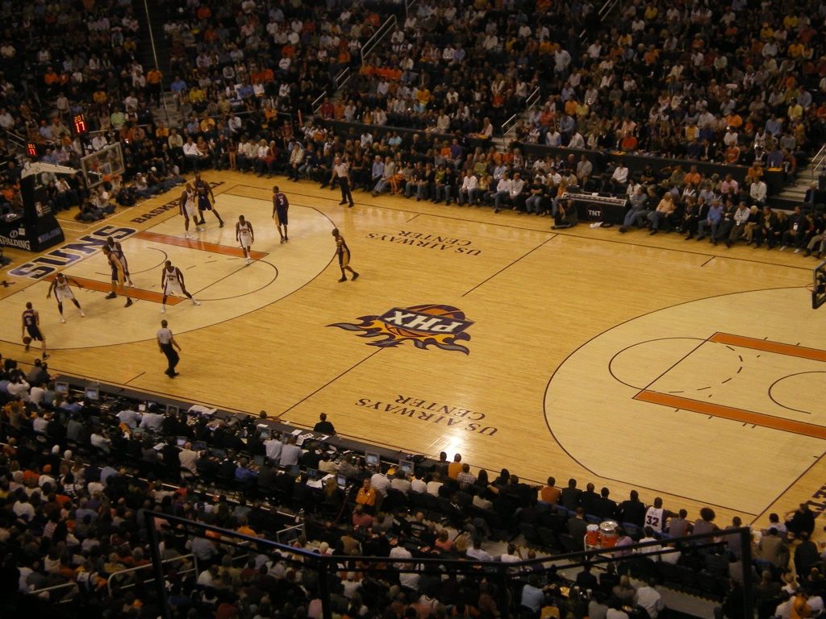
Focus on the Big Picture
“The Big Picture” is like looking from the top row in a stadium. You can see all of the field.
Stay focused on your dreams
33

Slide 34
Focus on the Big Picture
Have you ever dreamed of doing something or being like someone?
Your Dreams can be like a “Big Picture” for your life
Stay focused on your dreams
34

Slide 35
Focus on the Big Picture
“Your Dreams”
The key to success is to focus on your dreams…
and not on the things you are afraid of!
Stay focused on your dreams
35

Slide 36
Focus on the Big Picture
“Your Dreams”
“The only thing that will stop you from fulfilling your dreams is you.”
– Tom Bradley
Stay focused on your dreams
36

Slide 37
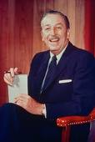
The Dream Zone
Dreams can come true
One of the greatest dreamers of our time was Walt Disney.
Did you know he created the first sound cartoon, the first all-colour cartoon, and the first animated feature length motion picture?
Not only was he not afraid to dream, he was not afraid to walk those dreams into reality.
Stay focused on your dreams
37

Slide 38
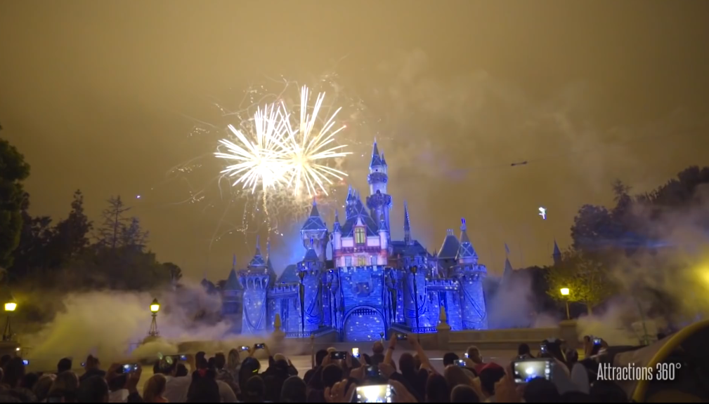
https://www.youtube.com/watch?v=TIScOrfhGq8
38

Slide 39

The Dream Zone
Dream BIG Dreams
“If you can dream it, you can do it.” Walt Disney
Stay focused on your dreams
39

Slide 40
The Dream Zone
Like a tiny seed you have everything inside of you NOW to start growing your DREAMS
A tiny seed can begin a garden
How do you think you can find your dreams?
Stay focused on your dreams
40

Slide 41
VISION
The Dream Zone
Find your dreams by listening to
YOURSELF not OTHERS
This is a time to focus on
YOURSELF
Stay focused on your dreams
41

Slide 42
You are now entering the
“Dream Zone”
Take the time to be quiet and listen to yourself not others
Let your thoughts fly and write them down
What thrills you?
What do you love to do for fun?
What would you love to be able to do?
Stay focused on your dreams
42

Slide 43
VISION
Prioritise Your DREAMS
Which are your most important dreams?
Which are the most feasible?
Which would you love to do the most?
Put them into the order you want to attain them
Stay focused on your dreams
43

Slide 44
The Dream Zone
Dreams can come true
These dreams are unique to you
Those who dream and act on them, live out their dreams
Stay focused on your dreams
44

Slide 45

The Dream Zone
“The future belongs to those who believe in the beauty of their dreams.” Eleanor Roosevelt
Stay focused on your dreams
45

Slide 46
VISION
Hold onto Your DREAMS
“Our thoughts create our reality - where we put our focus is the direction we tend to go.” Peter McWilliams
A tiny seed can begin a garden
Stay focused on your dreams
46

Slide 47
The Dream Zone
Dreams can come true
“The way to get started is to quit talking and begin doing.” Walt Disney
Begin the journey towards your dreams by setting some goals
47

Slide 48
VISION
Hold onto your DREAMS
Begin the journey towards your dreams by setting some goals
A tiny seed can begin a garden
What GOALS could you set today to begin SHOOTING for your DREAM?
Stay focused on your dreams
48

Slide 49

Goal Setting
What is a Goal?
A goal is something to...
Be aimed at
Progressively work towards over time
“Aim above the mark to hit the mark.” Ralph Waldo Emerson
Stay focused reach for your dreams set some goals
49

Slide 50
Goal Setting is…
A Process
A goal is something you...
Want
Plan how to achieve
Work towards one step at a time
Stay focused reach for your dreams set some goals
50

Slide 51

Tools for Goal Setting
What is a Goal?
Plan for it don’t just wish it
Stay focused...... Achieve your dreams
51

Slide 52
A Goal Setting Strategy
The Overall Plan
Decide what your first goal is
What steps do you need to take?
What obstacles might you expect?
Clear written GOALS programme you for success
Stay focused...... Achieve your dreams
52

Slide 53
A Goal Setting Strategy
The Overall Plan
Clear, written goals and visions programme you for success
These can be:
Daily
Weekly
Monthly
Yearly
5 yearly
Lifetime goals
Stay focused...... Achieve your dreams
53

Slide 54

Tools for Goal Setting
The value of FOCUS
Focus on the steps
Make a start
Go step by step
Meet obstacles along the way
Keep the dream in mind...but focus on the steps
Stay focused...... Achieve your dreams
54

Slide 55
Tools for Goal Setting
The value of FOCUS
Remain focused despite obstacles
“One aught never to turn one’s back on a threatened danger and try to run away from it...but if you meet it promptly and without flinching, you will reduce the danger by half.”
Sir Winston Churchill
Stay focused...... Achieve your dreams
55

Slide 56
Tools for Goal Setting
The value of FOCUS
What obstacles might you face along the way?
Ignoring obstacles may possibly stop you from starting to work towards your goals
Stay focused...... Achieve your dreams
56

Slide 57

Tools for Goal Setting
The value of FOCUS
Focusing on the small steps will help you overcome obstacles
Stay focused...... Achieve your dreams
57

Slide 58
Tools for Goal Setting
The value of FOCUS
Keep the BIG PICTURE in mind but don’t focus on that. Instead...
FOCUS on the steps you need to reach your goal
Stay focused...... Achieve your dreams
58

Slide 59
Tools for Goal Setting
Dealing with Negativity
The higher the goal, the more others may make fun of you
Stick to your path
Avoid negative people
Stay focused...... Achieve your dreams
59

Slide 60
Tools for Goal Setting
Dealing with Negativity
“ You need to overcome the tug of people against you as you reach for high goals.” General Patton
Jealousy... beware of the envy of others when you reach your goal
Stay focused...... Achieve your dreams
60

Slide 61
Tools for Goal Setting
Persistence
The dictionary says persistence is to continue in spite of obstacles and objections.
Persistence can become a habit
Persistence is essential for a world class athlete to perform
Persistence means keeping on keeping on - 1 step at a time
Stay focused reach for your dreams set some goals
61

Slide 62
Tools for Goal Setting
Choices
You and only YOU!
Take responsibility for your choices
Life is full of choices
Make it your goal to make the choices needed to move forward
Stay focused reach for your dreams set some goals
62

Slide 63
Going for Goal
The Road to Success
“All successful people are big dreamers.
They imagine what their future could be and then they work everyday towards their distant vision, that goal or purpose.” Brian Tracy
Stay focused reach for your dreams set some goals
63

Slide 64
Going for Goal
The Road to Success
What is your definition for success?
Achievement?
Fame?
But achievement in what?
Triumph?
Wealth?
Stay focused reach for your dreams set some goals
Stay focused reach for your dreams set some goals
64

Slide 65
Going for Goal
The Road to Success
Does success happen by accident?
Success happens by preparing,
planning and executing
Stay focused reach for your dreams set some goals
Stay focused reach for your dreams set some goals
65

Slide 66
Going for Goal
The Road to Success
Success doesn’t happen by accident
You have to plan for it
Stay focused reach for your dreams set some goals
66

Slide 67
Going for Goal
The Road to Success
You are successful the moment you start moving towards you goal
Take action by setting some S.M.A.R.T. Goals
Achieve your dreams through action
67

Slide 68
Going for Goal
Setting S.M.A.R.T Goals
S = Specific
Write down some simple clear goals
Stay focused reach for your dreams set some goals
68

Slide 69
Going for Goal
Setting S.M.A.R.T Goals
M = Measurable
You need to know when the goal has been reached
Stay focused reach for your dreams set some goals
69

Slide 70
Going for Goal
Setting S.M.A.R.T Goals
A = Attainable
Not too hard but not too easy either
Stay focused reach for your dreams set some goals
70

Slide 71
Going for Goal
Setting S.M.A.R.T Goals
R = Realistic
It’s highly likely that you can reach it
Stay focused reach for your dreams set some goals
71

Slide 72
Going for Goal
Setting S.M.A.R.T Goals
T = Timely
Set a time you want to achieve the goal by
Stay focused reach for your dreams set some goals
72

Slide 73
Going for Goal
Setting S.M.A.R.T Goals
S = Specific
M = Measurable
A = Achievable
R = Reachable
T = Timely
Stay focused reach for your dreams set some goals
73

Slide 74
Going for Goal
Keys to Success
“Things do not happen. They are made to happen.”
John F Kennedy
Stay focused reach for your dreams set some goals
74

Slide 75


Going for Goal
Keys to Success
PRACTICE
A special time when you work on activities to build strength and confidence
Achieve your dreams with practice
75

Slide 76
Going for Goal
Keys to Success
SKILLS
The activities you do during your practice time to help achieve your goals
Achieve your dreams with practice
76

Slide 77
ACTION
Keys to Success
Coming up with an ACTION PLAN will help you work towards your goals
Use your S.M.A.R.T. Goals to create your ACTION PLAN
Stay focused reach for your dreams set some goals
77

Slide 78
ACTION
Decisions v Actions
Decisions: Deciding to do something is considered a mental action.
Action: It becomes an action when the decision is carried out.
Action is the foundational key to all success. Pablo Picasso
Turn decisions into actions
78

Slide 79
ACTION
Initiative Definition
The ability to see an opportunity and take proper action
Showing INITIATIVE will help you to begin your ACTION PLAN
Initiative makes it happen
79

Slide 80
ACTION
Initiative Quote
“You can’t build a reputation on what you’re going to do.”
Abraham Lincoln
Initiative makes it happen
80

Slide 81
ACTION
Initiative
Combines aspects of:
Insight i.e. the ability to see an opportunity
Evaluation i.e. the ability to determine proper actions that can be evaluated
Initiative makes it happen
81

Slide 82
ACTION
Initiative
Initiative includes a willingness to apply your best personal effort
It’s about being BETTER THAN BEFORE
Initiative makes it happen
82

Slide 83
ACTION
Initiative
Take the initiative to solve problems
“Don't dwell on what went wrong. Instead, focus on what to do next.”
“Spend your energies on moving forward toward finding the answer.”
Denis Waitley
Use Initiative to help solve problems
83

Slide 84
ACTION
Problem Solving
Take the initiative to solve problems
Problems are opportunities to improve
Find the right problem to solve
Sometimes problems are not obvious
What are you getting frustrated with?
Why?
Use Initiative to help solve problems
84

Slide 85
ACTION
Problem Solving
Idea Finding
Focus 90% of your time on solutions and only 10% of your time on problems.
Anthony J. D'Angelo
Use Initiative to help solve problems
85

Slide 86
ACTION
Problem Solving
Select an Idea
Focus on remedies, not faults.
Jack Nicklaus
Use Initiative to help solve problems
86

Slide 87
ACTION
Problem Solving
Idea Finding
Create as many problem solving ideas as possible
Be creative in your thinking...don’t allow “I can’t” or “I don’t” when brainstorming ideas
Use Initiative to help solve problems
87

Slide 88
ACTION
Problem Solving
Select an Idea
Select the best idea
Develop all of the possibilities for your best idea
Plan how you can implement your idea using the S.M.A.R.T. Goals process
Use Initiative to help solve problems
88

Slide 89
ACTION
Problem Solving
Finally after all of your creativity and planning...
TAKE ACTION
Use Initiative to help solve problems
89

Slide 90

Initiative means
Seizing Opportunities
Seeing something that needs doing and doing something about it.
Initiative makes it happen
90

Slide 91
ACTION
Initiative
Seizing Opportunities
The best reward for taking initiative is the satisfaction of finishing a task
Initiative makes it happen
Initiative makes it happen
91

Slide 92
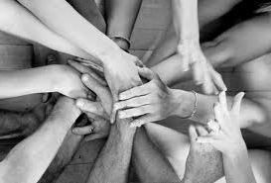
ACTION
Initiative
Taking it into your own hands
Look around this week and see what needs to be done
Initiative makes it happen
92

Slide 93
ACTION
Initiative
What we’ve learnt about initiative?
INITIATIVE is seeing what needs to be done and doing it
What we have learnt about initiative? | How have we shown initiative?
Initiative makes it happen
93

Slide 94
ACTION
Initiative
I have shown initiative by...
I could show more initiative by...
I’ve seen initiative shown by others when I saw them...
Initiative makes it happen
94

Slide 95
Initiative
Do you think initiative is a worthwhile value?
Why?
How do you think it will make you a better person?
Initiative makes it happen
95

Slide 96
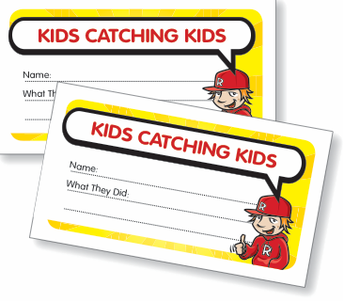
ACTION
Initiative
KIDS Catching KIDS!
See someone in your class showing initiative?
Write down their names on a ”KIDS Catching KIDS” Initiative Card
and post it in the KIDS Catching KIDS Box
Initiative makes it happen
96

Slide 97
Hold Onto Your DREAMS
My Dream by
_____________________
I want to
___________________________________
This is important to me because
_________________________________________
_________________________________________
A tiny seed can begin a garden
Stay focused...... Achieve your dreams
97

Slide 98
Going for Goal
The goal I’m shooting for is
____________________________________
Stepping Stones Action steps I can take include:
The action step I’m going to start with is: ____________ ___________________________________________ ___________________________________________
Stay focused...... Achieve your dreams
98

Slide 99
Shooting for Goal
My S.M.A.R.T. Goal Action Plan
S = Specific: My goal is to _______________________________ _______________________________________________________
M = Measurable: I will know when I’ve reached my goal when I _______________________________________________________
A = Attainable: This goal is important to me because __________ _______________________________________________________
R = Realistic: I can make this goal realistic by ______________ _______________________________________________________
This goal will take me a step closer to my dream because__________
_______________________________________________________
T = Timely: I want to achieve this goal by ___________________
_______________________________________________________
Stay focused reach for your dreams set some goals
99

Slide 100
Focus
Remember you are unique and there is no one else like you
“It's important not to focus on yourself too much.” Nicole Kidman
Keep a balance between a focus on yourself and a focus on others
Focus on yourself and others
100

Slide 101
Vision
Focus on the “BIG PICTURE”
Take time to “DREAM DREAMS”
A tiny seed can begin a garden
Your DREAMS can come true
Stay focused on the big picture
101

Slide 102
Goals
Take Aim
Set S.M.A.R.T Goals
S = Specific
Step
M = Measurable
Towards
A = Attainable
Your
R = Realistic
Dreams
T = Time
Focus, dream, set goals, take aim and take action
102

Slide 103
Action
Decide what’s important to you as a person and then take the INITIATIVE to make it happen.
Step
by
Step
Focus, dream, set goals, take aim and take action
103

Slide 104
Stay FOCUSED
Have a VISION of your DREAMS
Set some GOALS
Take ACTION
Step
A tiny seed can begin a garden
by
Step
104

