Slide 1



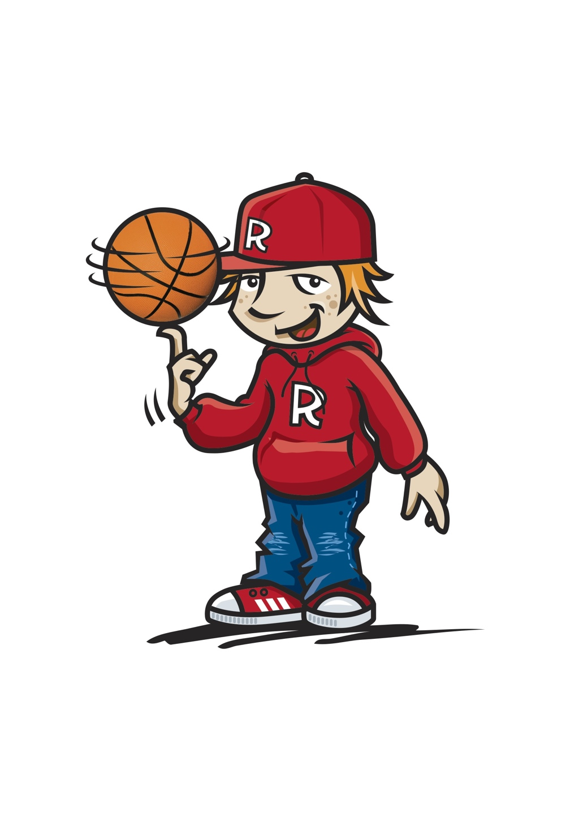
Winning Your Game of Life by
Being Focused
1

Slide 2
Focus
Definition
To bring to your attention
Focus your attention
2

Slide 3
Focus
What is an optical illusion?
Optical illusions are interesting pictures which need to be viewed with focus
They seem to our eyes to be something which they are not
Focus your attention
3

Slide 4
Focus
What’s odd about this picture?
Focus your attention
4

Slide 5
Focus
What can you see in this picture?
Focus your attention
5

Slide 6
Focus
What can you see in this picture?
Focus your attention
6

Slide 7
Focus
What happens to the arrows when you stare at the centre of the pictures?
Focus your attention
7

Slide 8
Focus
What can you see?
A man playing a horn or a lady’s face?
Focus your attention
8

Slide 9
Focus
A rabbit looking right or a duck looking left?
Focus your attention
9

Slide 10
Focus
What do you see?
Focus your attention
10

Slide 11
Focus
2 areas to FOCUS on
Yourself
Others
11

Slide 12
Focus
“I believe that as much as you take, you have to give back.
It's important not to focus on yourself too much.” Nicole Kidman
Focus your attention on others
12

Slide 13

A Focus on Others
No act of kindness, no matter how small, is ever wasted.
Aesop
13

Slide 14

A Focus on Others
Brainstorm Relay
What does being kind mean?
Being kind means…
14

Slide 15
A Focus on Others
Become a bucket filler
What can you do to fill other people’s buckets?
15

Slide 16
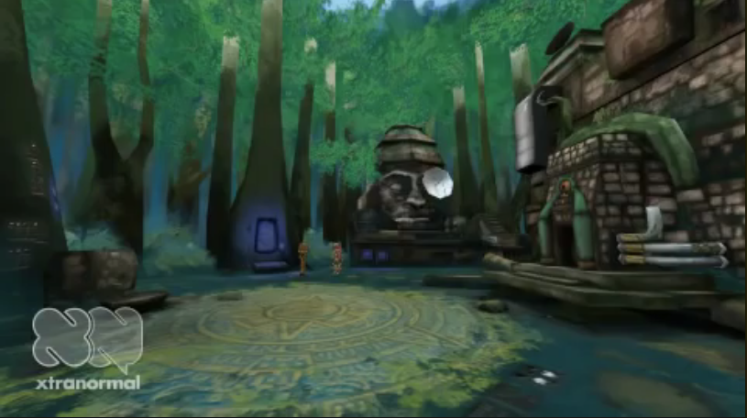
Become a bucket filler not a bucket dipper
Being nice makes you feel better too
https://www.youtube.com/watch?v=Vrd0lmQnBTw
16

Slide 17
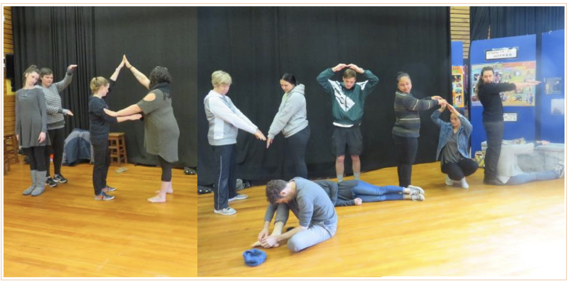
A Focus on Others
Kindness
17

Slide 18
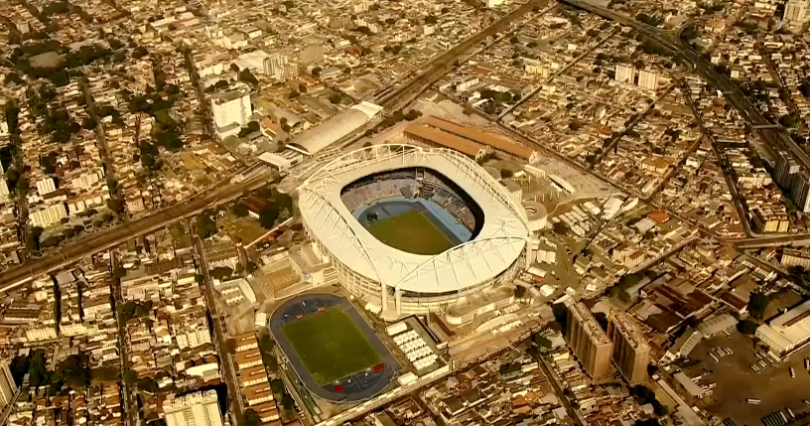
Love and kindness are never wasted…they always make a difference Agree or disagree? Why?
What difference did kindness make here?
https://www.youtube.com/watch?v=dCVlRFWOjgE
18

Slide 19
A Focus on Others
What does kindness mean to you?
19

Slide 20
A Focus on Others
The 5 Day Bucket Filling Class Challenge
Monday | Tuesday | Wednesday | Thursday | Friday
What can you do this week to make a positive difference in your classroom?
20

Slide 21
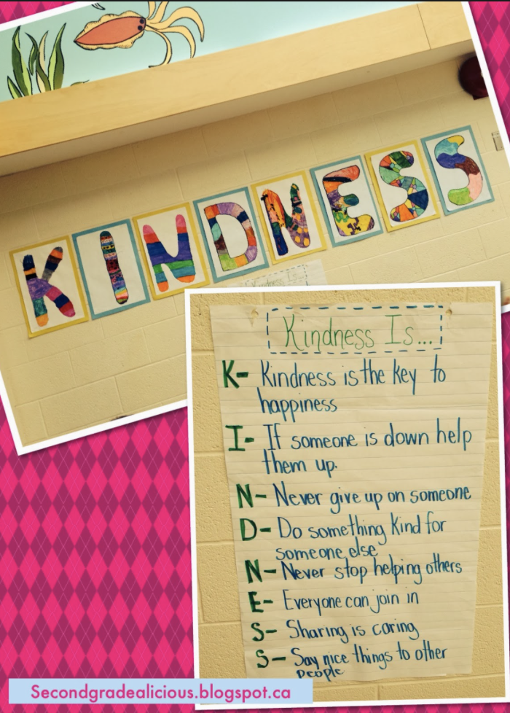
A Focus on Others
What does kindness mean to you?
Create a video that explains what kindness means
21

Slide 22
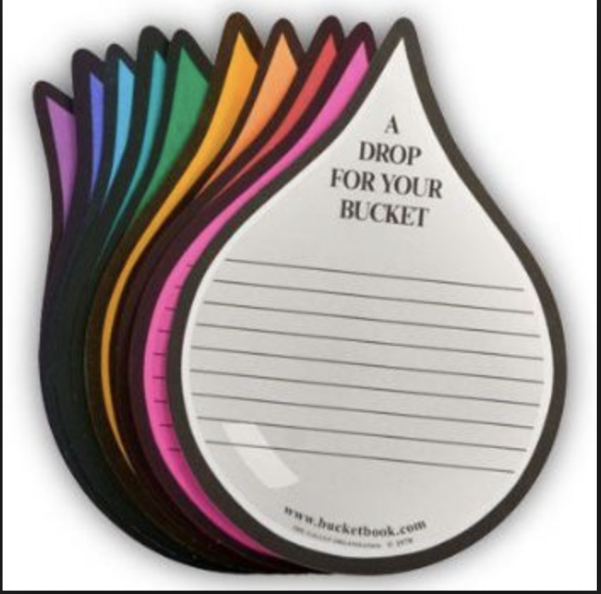
A Focus on Others
No act of kindness is ever too small Author unknown
Compliment Circle Starters
I think you…
You are…
I like the way you…
Thank you for…
You are good at…
You worked really hard at
Good job showing…
It was nice of you to…
You were a good friend when you…
22

Slide 23
A Focus on Others
What are some things you could focus on to help your friends?
What are some things you could focus on to help others in class?
What are some things you could focus on to be helpful at home?
Focus your attention on others
23

Slide 24
A Focus on Others
The 5 Day Bucket Filling Family Challenge
Monday | Tuesday | Wednesday | Thursday | Friday
As a family come up with 5 ways you can practice filling everyone’s buckets at home
24

Slide 25
A Focus on Self
You are one of a kind!
No one on earth exists quite like you!
25

Slide 26

Uniqueness
Definition
You are 1 of a kind
You are the only one
Focus on yourself...you are unique
26

Slide 27
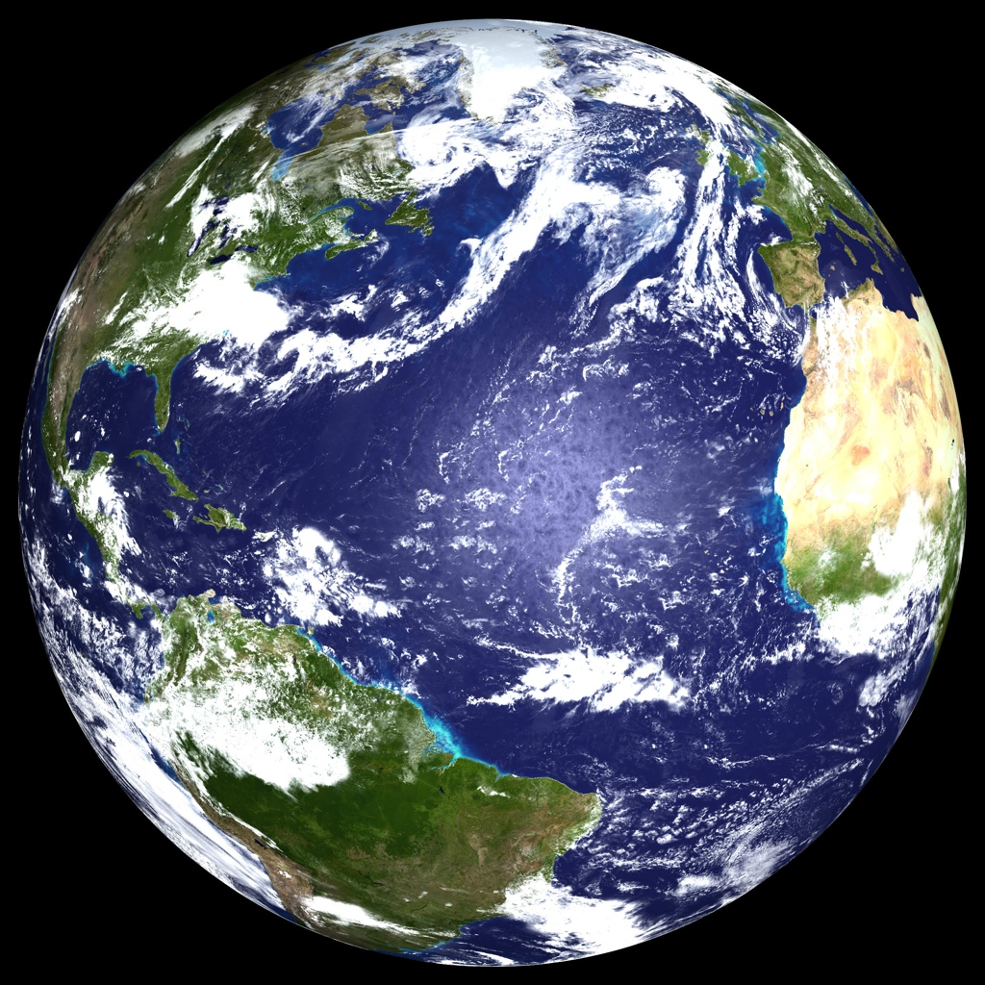
Uniqueness
Only You
No one on earth
Exists quite like you,
And no one is able
To do what you do.
Focus on yourself...you are unique
27

Slide 28

Uniqueness
Only You
The person you are
The talents you bear,
Gifts that only
You can share.
Focus on yourself...you are unique
28

Slide 29
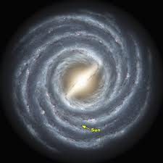
Uniqueness
Only You
The things you do
The things you say,
Send ripples throughout
The Milky Way.
Focus on yourself...you are unique
29

Slide 30
Uniqueness
Only You
You’re unique, amazing
Like no one else,
You have the exclusive
On being yourself
by Dan Coppersmith
Focus on yourself...you are unique
30

Slide 31
Uniqueness
Thumbprint Patterns
Arch
Loop
Whorl
“Don’t let anyone tell you that you have to be a certain way. Be unique.”
Melissa Etheridge
Focus on yourself...you are unique
31

Slide 32

U R Unique
Rip a piece of paper into 10 strips
On each strip write a word or phrase that describes you
Focus on yourself...you are unique
32

Slide 33
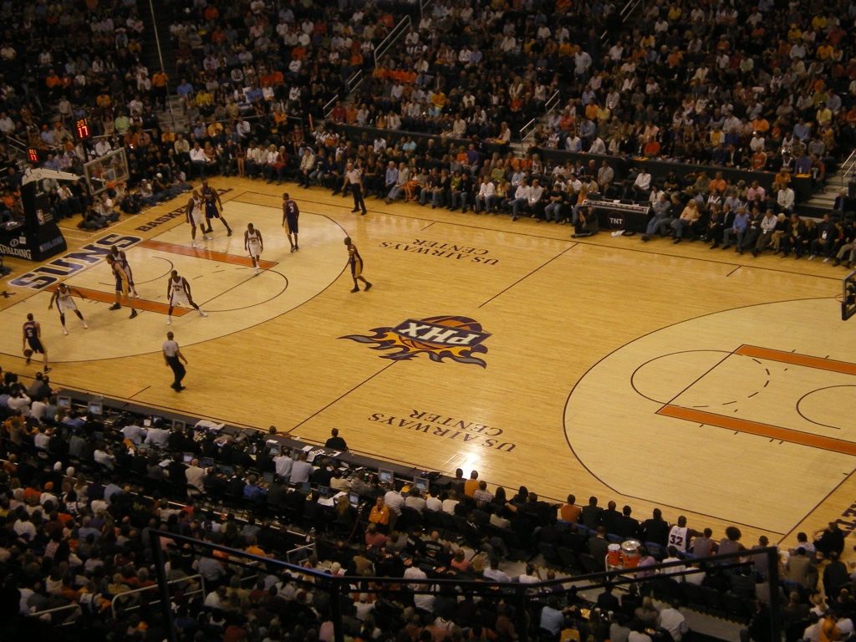
Focus on the Big Picture
“The Big Picture” is like looking from the top row in a stadium. You can see all of the field.
Stay focused on your dreams
33

Slide 34
Focus on the Big Picture
Have you ever dreamed of doing something or being like someone?
Your Dreams can be like a “Big Picture” for your life
Stay focused on your dreams
34

Slide 35
Focus on the Big Picture
“Your Dreams”
The key to success is to focus on your dreams
Stay focused on your dreams
35

Slide 36
Focus on the Big Picture
“Your Dreams”
“The only thing that will stop you from fulfilling your dreams is you.”
– Tom Bradley
Stay focused on your dreams
36

Slide 37
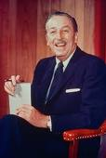
The Dream Zone
Dreams can come true
One of the greatest dreamers of our time was Walt Disney.
Did you know he created the first sound cartoon, the first all-colour cartoon, and the first animated feature length motion picture?
Not only was he not afraid to dream, he was not afraid to walk those dreams into reality.
Stay focused on your dreams
37

Slide 38
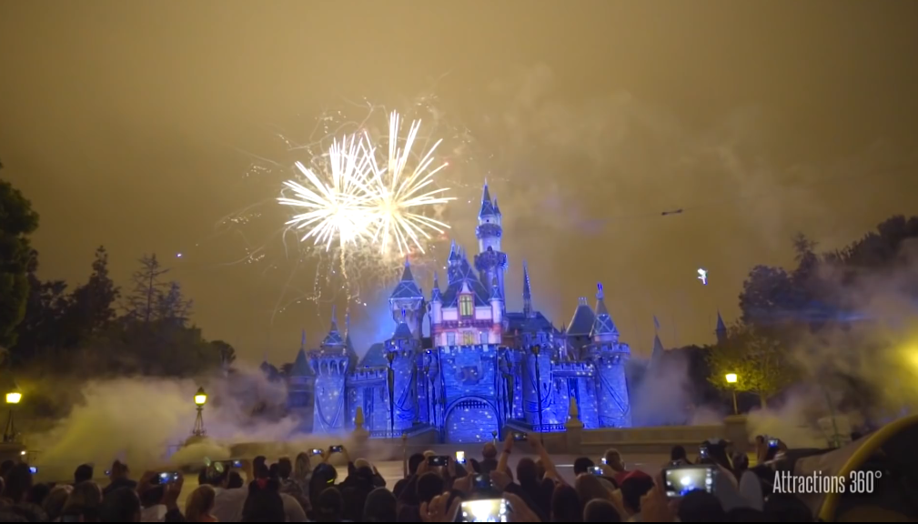
https://www.youtube.com/watch?v=TIScOrfhGq8
38

Slide 39

The Dream Zone
Dream BIG Dreams
“If you can dream it, you can do it.” Walt Disney
Stay focused on your dreams
39

Slide 40
The Dream Zone
Like a tiny seed you have everything inside of you NOW to start growing your DREAM
A tiny seed can begin a garden
How do you think you can find your dreams?
Stay focused on your dreams
40

Slide 41
VISION
The Dream Zone
Find your dreams by listening to
YOURSELF not OTHERS
This is a time to focus on
YOURSELF
Stay focused on your dreams
41

Slide 42
You are now entering the
“Dream Zone”
Take the time to be quiet and listen to yourself not others
Let your thoughts fly and write them down
What thrills you?
What do you love to do for fun?
What would you love to be able to do?
Stay focused on your dreams
42

Slide 43
Hold Onto Your DREAMS
“I think being a competitive diver for years helps you focus and dedicate yourself to what's needed.”
Jason Statham
Focus your attention
43

Slide 44
The Dream Zone
Dreams can come true
“The way to get started is to quit talking and begin doing.” Walt Disney
Begin the journey towards your dreams by setting some goals
44

Slide 45
SHOOTING for GOALS
will help you to begin to work towards your DREAMS
A tiny seed can begin a garden
Stay focused reach for your dreams set some goals
45

Slide 46

Goal Setting
What is a Goal?
A goal is something to...
Be aimed at
Work towards over a period of time
Plan for
Stay focused reach for your dreams set some goals
46

Slide 47
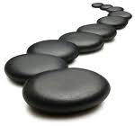
Goal Setting
A Plan for Success is...
Something you plan for not just wish or dream about
Something you write down
A list of steps you need to do to achieve your goal
Stay focused reach for your dreams set some goals
47

Slide 48
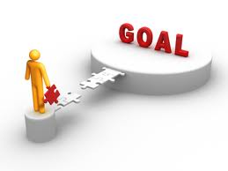
Tools for Goal Setting
The value of FOCUS
Focus on the steps
Make a start
Go step by step
Meet obstacles along the way
Keep the dream in mind...but don’t focus on it. Focus on steps
Stay focused reach for your dreams set some goals
48

Slide 49
Tools for Goal Setting
Dealing with negativity
Don’t let others take your focus off your dreams by making fun of them
What are some things people might do or say?
How might you respond?
Stay focused reach for your dreams set some goals
49

Slide 50
Tools for Goal Setting
Perseverance
Life isn’t easy for anyone
Focus on small steps
Your confidence grows when you’re successful with the small steps
Stay focused reach for your dreams set some goals
50

Slide 51
Tools for Goal Setting
Self Confidence
Is necessary to be successful
Identify your steps for success
Use a step-by-step approach
As you achieve each step your confidence will grow
Stay focused reach for your dreams set some goals
51

Slide 52
Tools for Goal Setting
Growing your Self Confidence
Create a Self Collage
Use pictures, words or symbols clipped from magazines that represent:
Things you enjoy doing
Things you own
Places you’ve been to
People you admire
Careers you want to follow
Stay focused reach for your dreams set some goals
52

Slide 53
Tools for Goal Setting
Setting S.M.A.R.T Goals
S = Specific
A goal has a greater chance of being achieved if you are specific
Stay focused reach for your dreams set some goals
53

Slide 54
Tools for Goal Setting
Setting S.M.A.R.T Goals
M = Measurable
When you measure your progress you are more likely to stay on track
Stay focused reach for your dreams set some goals
54

Slide 55
Tools for Goal Setting
Setting S.M.A.R.T Goals
A = Attainable
Identify the goals that are most important to you
Stay focused reach for your dreams set some goals
55

Slide 56
Tools for Goal Setting
Setting S.M.A.R.T Goals
R = Realistic
To be realistic a goal must be something you are willing and able to do
Stay focused reach for your dreams set some goals
56

Slide 57
Tools for Goal Setting
Setting S.M.A.R.T Goals
T = Time
Set a time you want to achieve the goal by
Stay focused reach for your dreams set some goals
57

Slide 58
Tools for Goal Setting
Setting S.M.A.R.T Goals
S = Specific
M = Measurable
A = Attainable
R = Realistic
T = Time
Stay focused reach for your dreams set some goals
58

Slide 59
Tools for Goal Setting
Persistence
The dictionary says persistence is, “To continue in spite of obstacles and objections.”
Persistence helps you to reach your goals
What are some ways people could give objections or act as obstacles?
Stay focused reach for your dreams set some goals
59

Slide 60
Tools for Goal Setting
Persistence
The dictionary says persistence is, “To continue in spite of obstacles and objections.”
Persistence means hard work
Persistence means keeping on keeping on - 1 step at a time
Stay focused reach for your dreams set some goals
60

Slide 61
Tools for Goal Setting
Take Action
Action is necessary to be successful
Identify your steps for success
Use a step-by-step approach
As you achieve each step your confidence will grow
Stay focused reach for your dreams set some goals
61

Slide 62
Tools for Goal Setting
Choices
You and only YOU!
Take responsibility for your choices
Life is full of choices
Decide to make the choices needed to move towards the goal
Stay focused reach for your dreams set some goals
62

Slide 63
The Dream Zone
What GOAL could you set today to begin SHOOTING for your DREAM?
A tiny seed can begin a garden
Stay focused on your dreams
63

Slide 64
Going for Goal
Goals are the road to success
What is your definition for success?
Fame?
Triumph?
Achievement?
Wealth?
“All successful people are BIG dreamers.”
Stay focused reach for your dreams set some goals
64

Slide 65
Plan for ACTION
Keys to Success
You are successful the moment you start moving towards your goals through...
ACTION
Achieve your dreams through action
65

Slide 66
Plan for ACTION
Keys to Success
“Things do not happen. They are made to happen.”
John F Kennedy
Achieve your dreams through action
66

Slide 67
Plan for ACTION
Keys to Success
“Joy is found not in finishing an activity but in doing it.” Greg Anderson
Focus on the journey, not the destination.
Achieve your dreams through action
67

Slide 68
Plan for ACTION
Keys to Success
Coming up with a plan will help you to start working towards your goals
INITIATIVE will help you begin your ACTION PLAN
Achieve your dreams through action
68

Slide 69
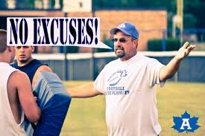
Initiative
Definition
“Seeing what needs to be done and doing it.”
NO EXCUSES!
Initiative makes it happen
69

Slide 70
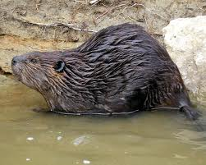
Initiative
The Beaver
Nature’s Initiative-Taker
Initiative makes it happen
70

Slide 71

Initiative means
Seizing Opportunities
Seeing something that needs doing and doing something about it.
The best reward for taking initiative is the satisfaction of finishing a task
Initiative makes it happen
71

Slide 72

Initiative means
Starting things
When you start something good other people will follow
Initiative makes it happen
72

Slide 73
Initiative means
Starting things
What do you need to do to start working towards your dreams and goals?
Initiative makes it happen
73

Slide 74
Initiative means
Doing what is expected of you without being asked
What can you do for your friends without being asked?
What can you do in class without the teacher asking you?
What can you do for your parents without being asked?
Initiative makes it happen
74

Slide 75
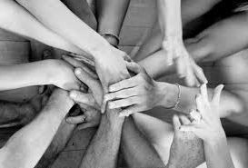
Initiative means
Taking it into your own hands
Look around this week and see what needs to be done
Initiative makes it happen
75

Slide 76
Initiative
I have shown initiative by...
I could show more initiative by...
I have seen initiative by others when...
Initiative makes it happen
76

Slide 77
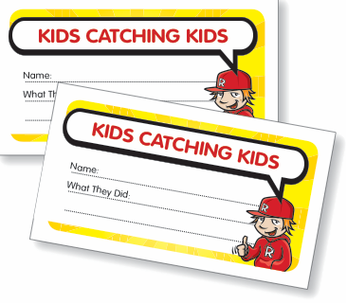
Initiative
KIDS Catching KIDS!
See someone in your class showing initiative?
Write down their names on a ”KIDS Catching KIDS” Initiative Card and post it in the KIDS Catching KIDS Box
Initiative makes it happen
77

Slide 78
Initiative
What we’ve learnt about initiative?
INITIATIVE is seeing what needs to be done and doing it
What we have learnt about initiative | How we have shown initiative
Initiative makes it happen
78

Slide 79
Initiative
Do you think initiative is a worthwhile value?
Why?
How do you think it will make you a better person?
Initiative makes it happen
79

Slide 80
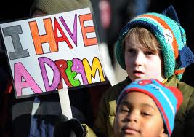
Shooting for Goal
One day I want to...
________________________________________
The goal I’m going to set to help me take aim towards my dream is ____________________________________ ____________________________ _____________________________
Stay focused achieve your dreams set some goals
80

Slide 81
My ACTION Plan
To shoot for my dreams by taking aim
Stepping Stones Towards My Goal
:
:
:
:
:
Stay focused achieve your dreams set some goals
81

Slide 82
Shooting for Goal
My S.M.A.R.T. Goal Action Plan
S = Specific: My goal is to _______________________________ _______________________________________________________
M = Measurable: I will know when I’ve reached my goal when I _______________________________________________________
A = Attainable: This goal is important to me because __________ _______________________________________________________
R = Realistic: I can make this goal realistic by ______________ _______________________________________________________
This goal will take me a step closer to my dream because__________
_______________________________________________________
T = Time: I want to achieve this goal by ____________________
_______________________________________________________
Stay focused achieve your dreams set some goals
82

Slide 83
ACTION
“After you have written your goals down take some form of positive action towards achieving them.”
Anthony Robbins
Take action to make it happen
83

Slide 84
Focus
Remember you are unique and there is no one else like you
“It's important not to focus on yourself too much.” Nicole Kidman
Keep a balance between a focus on yourself and a focus on others
Focus your attention
84

Slide 85
Vision
Focus on the “BIG PICTURE”
Take time to “DREAM DREAMS”
A tiny seed can begin a garden
Your DREAMS can come true
Stay focused on the big picture
85

Slide 86
Goals
Take Aim
Set S.M.A.R.T Goals
S = Specific
Step
M = Measurable
A = Attainable
Towards
R = Realistic
Your
Dreams
T = Time
Stay focused achieve your dreams set some goals
86

Slide 87
Action
Decide what’s important to you as a person and then take the INITIATIVE to make it happen.
Step
by
Step
Focus, dream, set goals, take aim and take action
87

Slide 88
Stay FOCUSED
Have a VISION of your DREAMS
Set some GOALS
Take ACTION
Step
A tiny seed can begin a garden
by
Step
88

